Slide 1
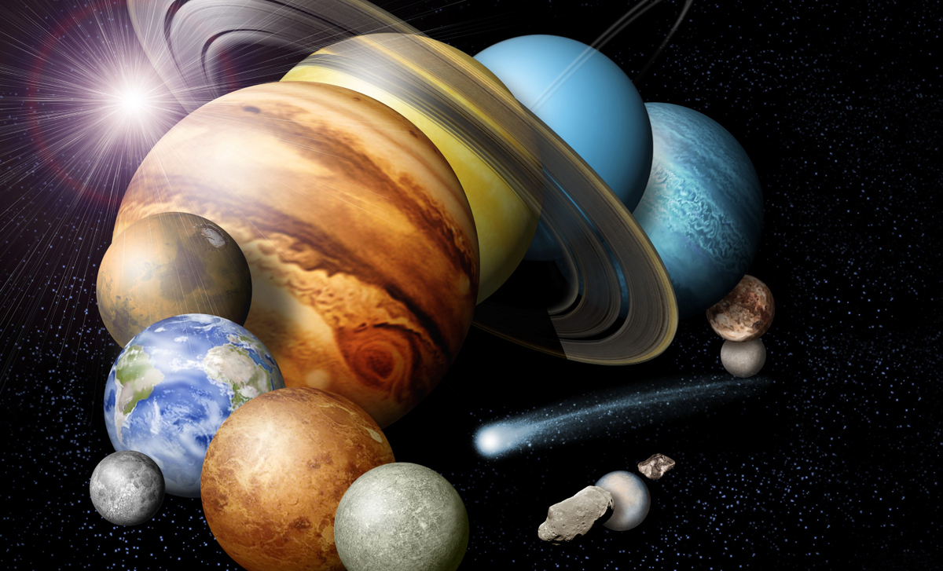
PDS Roadmap and Discussion
(Update on HQ Briefing)
Ralph L. McNutt, Jr.¹
¹The John Hopkins University Applied Physics Laboratory
Wednesday, 19 April 2017
1:15 PM – 3:15 PM
San Rafael Room, The Westin Hotel Pasadena, CA

Slide 2
Roadmap Study Status
Working to finalize a CONSENSUS Roadmap Study Report
Aim point remains end of this month to finalize the wording
Briefed at NASA HQ on 4 April – David Schurr and others in attendance
David brought up several items
Suggested that funds might be available to deal with some of these

Slide 3
Issues Being Worked
The Roadmap is a written document in terms of “Findings” and “Remediations”
The RST is not a FACA committee
~40 page report with ~60 pages of Appendices
Most of the document is complete
Content and supporting language still being worked on 4 potential items – all interrelated
3 Findings: “Node Structure,” “Governance,” and “Transparency”
“Executive Summary”

Slide 4
NASA Planetary Data System (PDS) Roadmap Progress Report
Ralph L. McNutt, Jr.¹, Ross A. Beyer^{2,3}, M. Katherine Crombie⁴, Denton Ebel⁵,
Lisa R. Gaddis⁶, Amitabha Ghosh⁷, Emily S. Law⁸, Thomas H. Morgan⁹,
Flora Paganelli^{3,10}, Anne C. Raugh¹¹, Matthew S. Tiscareno³, Thomas C. Stein¹²
¹The John Hopkins University Applied Physics Laboratory, ²NASA Ames Research Center, ³SETI Institute, ⁴Indigo Information Services, LLC, ⁵American Museum of Natural History, ⁶Astrogeology Science Center U. S. Geological Survey, ⁷Tharsis Inc., ⁸Jet Propulsion Laboratory, ⁹Goddard Space Flight Center, ¹⁰American Public University System, ¹¹ University of Maryland, ¹²Washington University
Tuesday, 4 April 2017
2:00 PM – 3:00 PM
NASA Headquarters MIC 3B (3J42 – B)
Washington, D.C.

Slide 5
Status
Roadmap Study Team (RST) is up and running
Telecoms now held every week (except for LPSC)
Face-to-Face meetings held 13-14 October 2016 and 8-10 February 2017 in Towson, Maryland
Current Draft report is 44 pages plus 57 pages of Appendices
Poster on progress presented at Lunar and Planetary Science Conference
Target completion of written report for April 2017 – prior to next PPBE – and still on track

Slide 6
The Planetary Data System aka PDS
Up and running since 1990
Responded to concerns raised that planetary data being returned by scientific satellites was in danger of being lost
The Committee on Data Management and Computation (CODMAC) was chartered by the National Academies to address the issue
On the basis of peer-reviewed proposals, discipline-oriented nodes were selected to form the core of the PDS.

Slide 7
PDS Functionality
Archives electronic data products from NASA planetary missions, sponsored by NASA's Science Mission Directorate
Makes peer-reviewed, documented, data available online to scientists and to the public without charge
Works closely with project teams to help them design well-engineered products that can be released quickly
Works closely with the community to provide higher order data products (and new archive materials) by supporting investigators in NASA’s Planetary Data Archiving, Restoration, and Tools Program (PDART).
Provides teams of scientists to help users select and understand the data and offers special processing for products tailored to the needs of individual users.

Slide 8
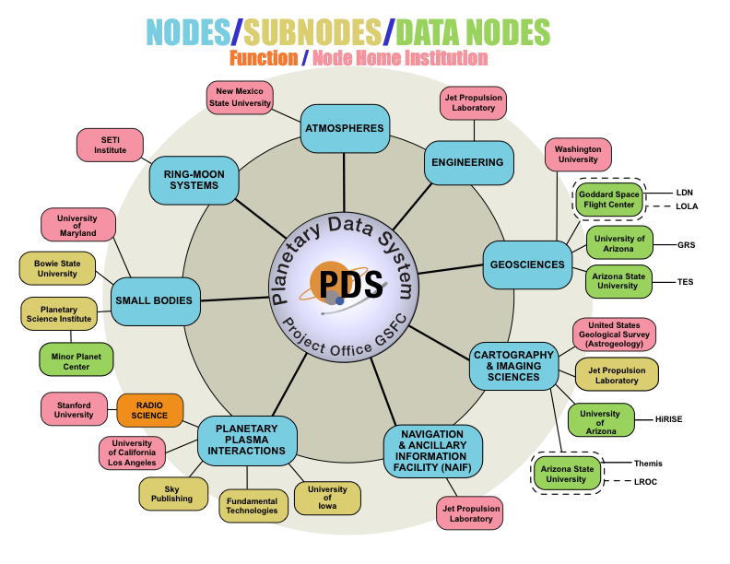
Current Organizational Structure
Federated system
Eight Discipline Nodes (competed and distributed)
Two technical support nodes (JPL)
Project Office (GSFC)

Slide 9
PDS Requirements
PDS will provide expertise to guide and assist missions, programs, and individuals to organize and document digital data supporting NASA's goals in planetary science and solar system exploration.
PDS will collect suitably organized and well-documented data into archives that are peer reviewed and maintained by members of the scientific community.
PDS will make these data accessible to users seeking to achieve NASA's goals for exploration and science.
PDS will ensure the long-term preservation of the data and maintain their usability.

Slide 10
What Is PDS Not Intended to Do?
PDS serves complex, high-volume data from a wide variety of instruments to a large number of stakeholders spread across the globe
While PDS responsibilities are extensive, it is important to note that per NASA policy and practice there are numerous activities that are outside the purview of PDS

Slide 11
What PDS does not do (1)
PDS does not set the mission archiving requirements.
PDS does not develop requirements for DMAPs and DMPs for AOs, ROSES, CANs.
PDS does not evaluate DMPs.
PDS does not develop pipelines for missions .
PDS does not develop higher-order data products.

Slide 12
What PDS does not do (2)
PDS does not actively participate in non-US mission data archiving without a NASA MOU or other agreement.
PDS does not accept telemetry data.
PDS does not archive executable software (see Finding XV).
PDS does not curate geologic samples, analog materials, or physical objects.

Slide 13
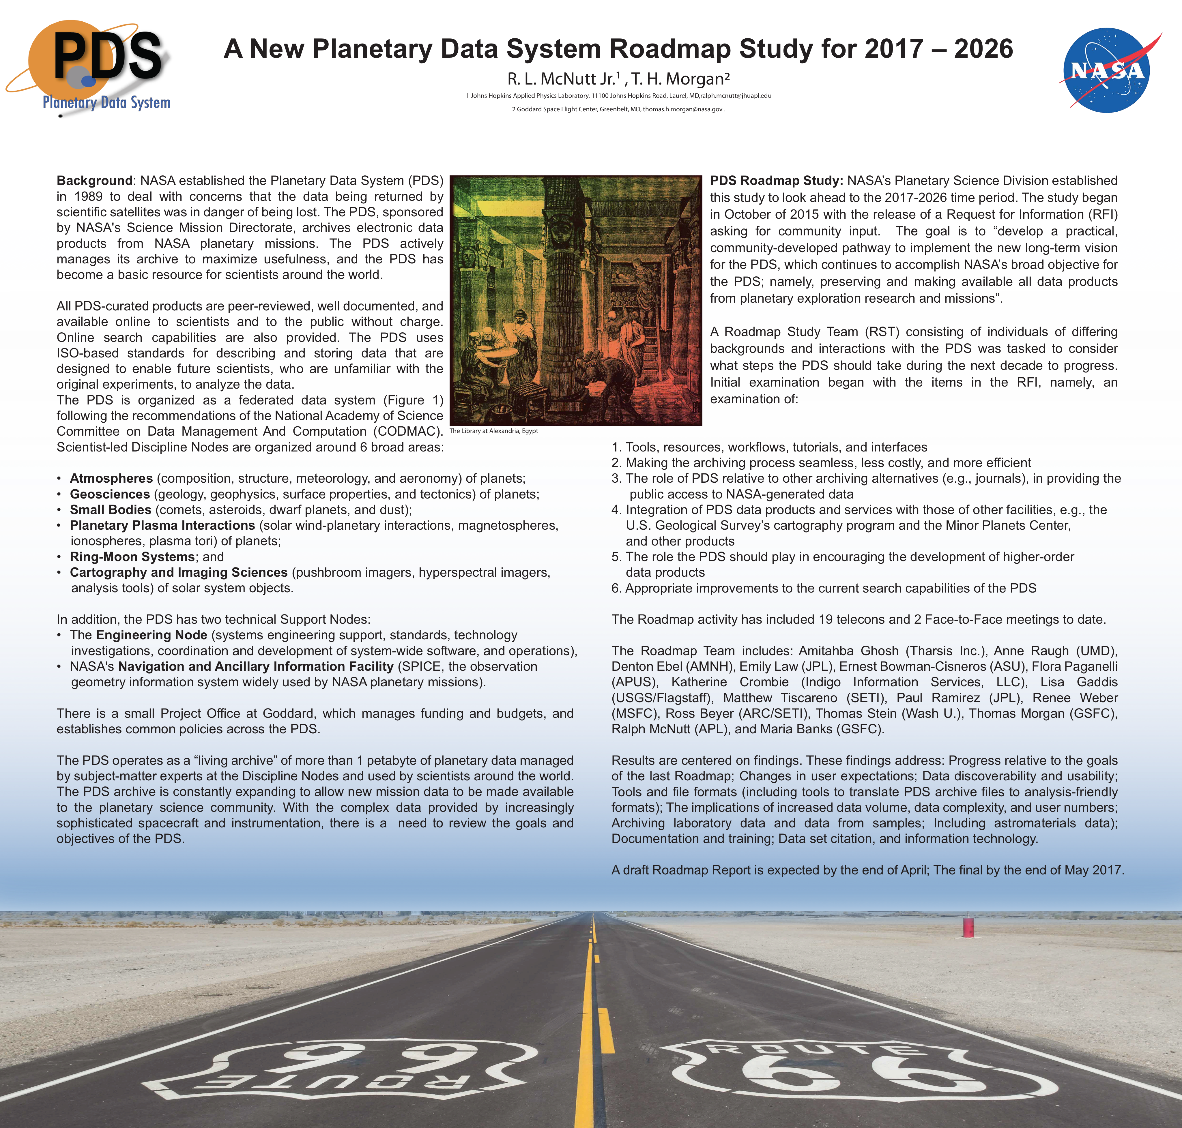

Slide 14
Establishment of the Roadmap Activity
NASA chartered this current PDS Roadmap Study Team to “develop a practical, community-developed pathway to implement the new long-term vision for the PDS, which continues to accomplish NASA’s broad objective for the PDS; namely, preserving and making available all data products from planetary exploration research and missions.”

Slide 15
Roadmap Study and Report

Slide 16
Contents
0. Executive Summary and Findings
1. Introduction
1.1. Establishment of the PDS
1.2. PDS Functionality
1.3. Current Organizational Structure
1.4. Data Holdings
1.5. PDS Information Model
1.6. Establishment of this Roadmap Activity
2. Planetary Data System Background
2.1. What is PDS and What Does It Do?
2.1.1. Differences from EOSDIS
2.1.2. Differences from Other NASA SMD Archives
2.1.3. Context of PDS and NASA Within the Digital Universe
2.2. PDS Requirements
2.3. What Is PDS Not Intended to Do?
2.4. Assessment of Progress Relative to the 2006 PDS Roadmap
2.5. Current PDS Structure and Implementation Plan for the Next 5 years
3. The Challenges Facing PDS Today
3.1. Changes in User Needs and Expectations
3.2. Data Discoverability
3.3. Data Usability
3.4. Tools and File Formats
3.5. Online Processing and Analysis
3.6. Increases in Data Volume, Variety, Complexity, and Number of Data Providers
3.7. Laboratory Data and Physical Samples
4. Issues, Observations, Findings, and Suggested Remediations or Actions
5. Conclusion / Summary
6. Acknowledgement
7. Acronyms
References
Appendix A. Roadmap Study Team (RST) Terms of Reference
Appendix B. RST Members
Appendix D. PDS Assessment of Progress 2006 - 2016 (Roadmap Self-assessments)
Appendix E. 2009 PDS User Survey summary
Appendix F. Membership and Organization of PDS, see About and Organization
Appendix G. 2014 PDS Requirements
Appendix H. 2015 Node Executive Summaries
Appendix I. 2015 PDS Charter
Appendix K. Decadal White Paper

Slide 17
Activities Guided by Findings
The Team formulated issues for the PDS for the next decade in the form of 16 “Findings”
Some of these have identified “Remediations” and some note good progress with the need for the same
The “Findings” are considered by the RST as objective facts that were developed over the course of extensive deliberations

Slide 18
Status of Findings
There is consensus amongst the Team members on 13 of the findings, including the facts surrounding their importance, their statement, and possible actions that could be contemplated on responding to them
There may be one more – likely on governance of the PDS
The goal is to reach consensus on all of these

Slide 19
Finding 0
While all PDS stakeholders are recognized as valuable, the prioritization of stakeholder interests and the impact those interests should have on PDS policy, design, and resource allocation are not clear.

Slide 20
Finding I
There is a mismatch between the services and functions PDS is equipped to provide and the very high expectations of its users and NASA Management.

Slide 21
Finding II
The PDS does an excellent job of providing access to its data holdings and is on track to increase such access. The latter is enabled by the PDS4 uniform metadata standard.

Slide 22
Finding III
The accessibility and discoverability through the PDS4 metadata registry is a cornerstone to the future of community interaction with the PDS as a coherent storehouse of data. Legacy data archived in PDS3 format (the vast majority of PDS holdings) often lack metadata sufficient to enable discovery and accessibility commensurate with PDS4.

Slide 23
Finding IV
There is a need of more translation programs that transform data from the PDS4 archive file formats to more usable analysis-ready formats.

Slide 24
Finding V
It is a matter of concern whether the PDS nodes will have the resources to serve the data archiving requirements of individual ROSES investigations.

Slide 25
Finding VI
A large amount of data from laboratory analyses of samples obtained by NASA missions is not archived and is in danger of loss. The status of astromaterials data archiving today is analogous to where planetary data archiving was before the PDS was chartered.

Slide 26
Finding VII
A large amount of data from laboratory analyses of meteorites and cosmic dust is not archived and is in danger of loss.

Slide 27
Finding VIII
The PDS4 information model is well-documented at a highly technical level. However, there is a critical need for broader documentation and training for all levels of users.

Slide 28
Finding IX
There is a need for PDS to both expand and focus its search services, with a view to making it easier for users to find and execute the search appropriate to their query.

Slide 29
Finding X
The PDS serves as the model for other national space mission data archives in ensuring future universal accessibility and searchability. The PDS is uniquely poised to lead efforts to make national and global archives interoperable.

Slide 30
Finding XI
PDS is actively involved in addressing the data citation issue, and is well-positioned to provide the essential links in the chain needed to enable clear, direct referencing of PDS products; but it cannot itself change the habits and attitudes of authors, referees, and journal editors when it comes to including data set references in publications.

Slide 31
Finding XII
Higher-order products produced by mission teams beyond what is in their original data management plans are extremely valuable additions to the archive, but are not always included due to lack of resources needed by the mission to complete the archiving process.

Slide 32
Finding XIII
The PDS has been and continues to be proactive in investigating information technology and adopting best practices.

Slide 33
Finding XIV
This Roadmap Study was initiated in the year immediately following a recompetition of the PDS Nodes, and will be completed at least 3 years and perhaps longer before the next recompetition, which limits the impact of a Roadmap Study activity on shaping the work of the PDS.

Slide 34
Finding XV
The PDS is not an appropriate archive or repository for software.

Slide 35
Appendices
The Appendices contain supporting material considered by the RST over the course of its deliberations
Much of this material is not easily accessible otherwise
These are included both to support the conclusions and statements of fact reached by the RST in support of its findings and to promote the transparency of that effort

Slide 36
Challenge for the Next Decade
As with any such large endeavor, there have been both known and unknown challenges, exacerbated with sometimes marginal budgets and the overall – and continuing – rapid evolution of IT infrastructure and how it impacts not only the U.S. digital world but the increasingly interconnected, and world-wide, “digital universe.”
Such changes, in hardware, software, and middleware continue to evolve.
Whether new approaches such as hyper-convergence or others yet to be defined will set the new infrastructure will be driven by the IT innovators, dealing with data access, storage, and manipulation on much large scales than of relevance here.
Nonetheless, it is in the best interests of the PDS, and indeed of all of NASA’s SMD Data Centers to remain early adopters, so as not to be left behind. This requires continued vigilance and investment, both in people and technology.

Slide 37
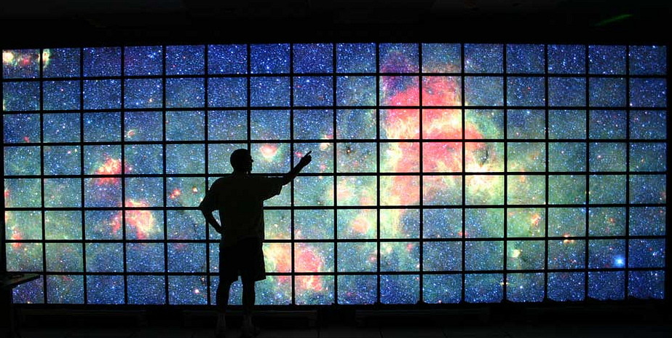
The Final Word – From the Conclusion / Summary
The Planetary Data System continues to fulfill a vital role in the preservation and curation of data obtained at great expense and with great effort from bodies other than Earth within the solar system. The risk of these data being lost forever, faced some 35 years ago has been averted. Upgrading PDS to PDS4 over the past decade has further enhanced the possibility of future preservation and use for the long term by securing the data collection to well-known and valued international standards for knowledge preservation and description.

Slide 38
The Library of Alexandria
Ptolemy soon took advantage of Demetrius’s wide and versatile knowledge and, about 295 BCE, charged him with the task of founding the library and the Mouseion.
From https://www.britannica.com/topic/Library-of-Alexandria

Slide 39
The Library of Alexandria
Galen preserved the information that was recorded for each book; it included the work’s title, author, and editor as well as its place of origin, length (in lines), and whether the manuscript was mixed (containing more than one work) or unmixed (a single text).
From https://www.britannica.com/topic/Library-of-Alexandria

Slide 40
The Library of Alexandria
Estimates of the total number of books in the library vary. The earliest surviving figure, from the 3rd century BCE, is reported as “more than 200,000 books,” whereas the medieval text of John Tzetzes mentions “42,000 books in the outer library; in the inner (Royal) Library 400,000 mixed books, plus 90,000 unmixed books.”
From https://www.britannica.com/topic/Library-of-Alexandria

Slide 41
The Library of Alexandria
Plutarch … after a personal visit to Alexandria, explained that “Caesar was forced to repel the danger by using fire, which spread from the dockyards and destroyed the Great Library.” Equally indicative is a statement by Strabo who, during a long stay in the city (c. 25–20 BCE), expressed in an indirect manner his regrets over the loss of that great library that had once supplied Eratosthenes and Hipparchus with the original reports of earlier discoveries, sources that were no longer there for him to consult.
From https://www.britannica.com/topic/Library-of-Alexandria

