Slide 1
Europa Clipper Mission:
Status of Mission Interface
Lisa Gaddis
PDS IMG: USGS, Astrogeology
PDSMC F2F, April 20, 2017

Slide 2
Europa Clipper Mission MI
Haje Korth (Haje.Korth@jhuapl.edu) replaces Louise Prockter as Deputy PI and leadership POC for data archiving
Elmain Martinez is Archive Lead at JPL
Elmain.Martinez@jpl.nasa.gov
Manages DAWG, collaboration Web site
Delivered PDS information in April, 2016
PDS and PDS4 information and contacts, sample docs
Proposed schedule
PDS Instrument Leads (POCs)
ECM identified instrument POCs in July 2016
MOU signed by IMG and ECM representatives in early April 2017
2

Slide 3
Europa Clipper Mission MI
Updated archiving schedule available
Delayed because of budget reductions
IMG continues informal monthly telecons with Elmain
Pre-PSG DAWG meeting TBD (soon?)
ECM and PDS Instrument POCs, if possible
ECM PSG meeting in May 17-19 in Columbia, MD
I will attend for PDS
First formal DAWG scheduled for ~Sept 2017
Elmain now working on:
Updates to Europa Clipper Science Data Sharing, Management, and Archive Plan (DSMAP)
Setting up collaboration Web site
Will attend PDS4 training at 3rd Planetary Data Workshop on June 14, 2017
3

Slide 4
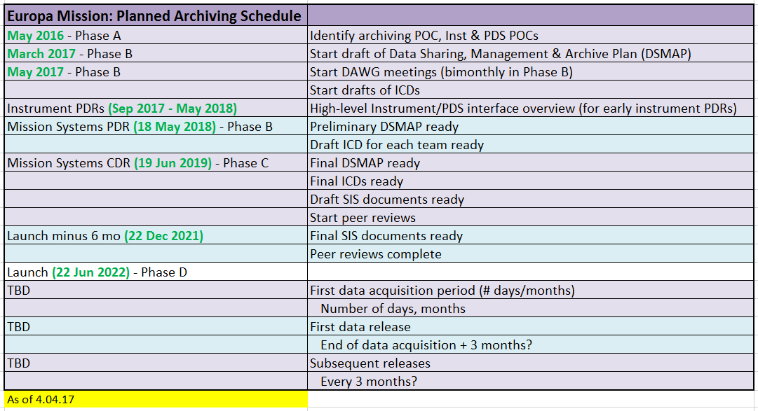
Current Archiving Schedule
4

Slide 5
ECM: Instrument Team POC Assignments
Instrument Team | Instrument Archiving Lead | PDS Node | Primary Node POC | Secondary Node POC (if any)
Plasma Instrument for Magnetic Sounding (PIMS) | Joe Westlake (sjoy@igpp.ucla.edu) | PPI | Joe Mafi (jmafi@igpp.ucla.edu )
Interior Characterization of Europa using Magnetometry (ICEMAG) | Steve Joy (BTrantham@swri.edu) | PPI | Joe Mafi (jmafi@igpp.ucla.edu )
Mapping Imaging Spectrometer for Europa (MISE) | Sarah Lundeen (sarah.r.lundeen@jpl.nasa.gov) | GEO | Ed Guinness (guinness@wunder.wustl.edu) | Matt Tiscareno (matt@seti.org)
Europa Imaging System (EIS) | Wes Patterson (Gerald.Patterson@jhuapl.edu) | IMG | Moses Milazzo (moses@usgs.gov) | Matt Tiscareno (matt@seti.org)
Radar for Europa Assessment and Sounding: Ocean to Near-Surface (REASON) | Duncan Young (duncan@ig.utexas.edu) | GEO | Ed Guinness (guinness@wunder.wustl.edu)
Europa Thermal Emission Imaging System (E-THEMIS) | Kim Murray (kim.murray@asu.edu) | IMG | Jordam Padams (Jordan.H.Padams@jpl.nasa.gov) | Matt Tiscareno (matt@seti.org)
Mass Spectrometer for Planetary Exploration/Europa (MASPEX) | Rebecca Perryman (rperryman@swri.edu) | ATM | Lyle Huber (lhuber@nmsu.edu)
Ultraviolet Spectrograph/Europa (UVS) | Brad Trantham (BTrantham@swri.edu) | ATM | Lyle Huber (lhuber@nmsu.edu)
Surface Dust Mass Analyzer (SUDA) | David James (David.James@lasp.colorado.edu) | SBN | Carol Neese (neese@psi.edu)
TECH DEVELOPMENT: Space Environmental and Composition Investigation near the Europan Surface (SPECIES) | None | (ATM) | Lyle Huber (lhuber@nmsu.edu)
Gravity Science | TBD | RS | Richard Simpson (radiosci@att.net)
15

Slide 6
Europa Mission: PDS TBD
PDS POCs to contact Instrument POCs
Additional examples of docs (ICDs, etc.)
Assistance with reviewing
Any sample labels, PDS4 guidance, tools
Stay tuned for information on
Introductory DAWG in April/May 2017 (?)
Collaboration Web site or Wiki
6

