Slide 1
PDS4 Glossary
Purpose
Establish common terms, definitions, and usage
For incorporation into PDS4 documents as they are written
Logistics
Glossary will be on-line, available to all
Status:
December draft partly included in Internal Assessment
Near final draft now, so documents can proceed
But it will always be a work-in-progress
Issues
Internal (dis)agreements within PDS
Some terms do not work well across documents at different levels of presentation (novice vs in-house technical people)

Slide 2
Building Blocks (pyramid model from Todd King in his Assessment comments)

Slide 3
Building Blocks (pyramid model from Todd King in his Assessment comments)
Containers, packages needed for delivery
Products are made from objects which are made from …

Slide 4
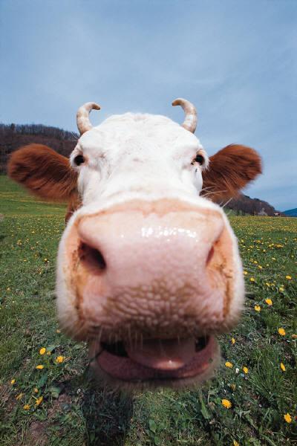
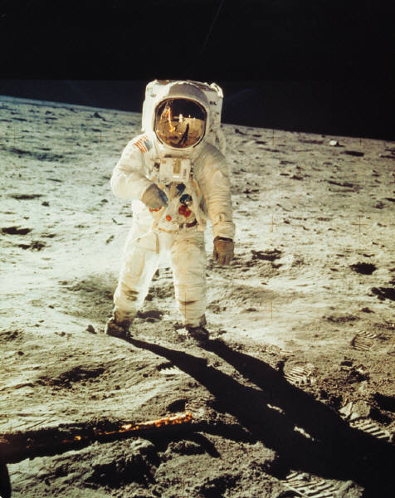
Building Blocks - Objects
Image of a cow or image of an astronaut
structure <->reading
content <-> meaning
cow
mission

Slide 5
Building Blocks – Overlapping Terms (dirty laundry department: OAIS vs PDS4 IM vs common sense)
This is a TAGGED DIGITAL OBJECT in the PDS4 model
Image of a cow or image of an astronaut
BITS > 0
BITS = 0
cow
These are TAGGED NON-DIGITAL OBJECTS in the PDS4 model
BITS = 0
mission
These are all called DATA OBJECTS in the PDS4 model even though only DIGITAL OBJECT has anything to do with ‘data’. The parallel structure helps in the modeling.

Slide 6
Attribute
A property or characteristic that provides a unit of information. For example, each of the following is an attribute:
HEAD = WHITE
HORNS = 2
NOSE = PINK
TONGUE = PINK
MASS = 500 <kg>
HEIGHT = 160 <cm>
EYES = 2
FEET = 4

Slide 7
Meta-Attribute
An attribute of an attribute. For example, what exactly do we mean by HORNS?
DESCRIPTION/DEFINITION
DATA TYPE
ENUMERATED VALUES?
MINIMUM/MAXIMUM VALUES?
MINIMUM/MAXIMUM CHARACTERS?
UNIT OF MEASURE
WHO MAINTAINS META-ATTRIBUTES?

Slide 8
Class
The set of attributes (including a name) which defines a family. A class is generic — a template from which a family may be constructed. For example:
CLASS = COW
can be defined by attributes
HEAD
HORNS
NOSE
TONGUE
MASS
HEIGHT
EYES
FEET

Slide 9
Class – Example 2
The set of attributes (including a name) which defines a family. A class is generic — a template from which a family may be constructed. For example:
CLASS = FARMER
can be defined by (different) attributes
HAT
NOSE
TONGUE
MASS
HEIGHT
EYES
FEET
HANDS

Slide 10
Association
An attribute that establishes a unidirectional relationship between two classes. For example:
OWNS COW
is a relationship between
FARMER and COW
OWNS COW

Slide 11
Data Element
A building block in a data model. Attributes (including associations) and classes are the building blocks of the PDS4 Information Model.
Notes:
‘data element’ is distinct from ‘elements’
ELEMENTS is a PDS4 attribute
‘data element’ is distinct from ‘XML element’
‘XML ELEMENT’ is an XML structure

Slide 12
Object
A single realization of a family member, defined by a class. For example, the attributes below define two objects of the COW class:
HEAD = WHITE HEAD = WHITE
HORNS = 2 HORNS = 2
NOSE = PINK NOSE = PINK
TONGUE = PINK TONGUE = PINK
MASS = 500 <kg> MASS = 480
HEIGHT = 160 <cm> HEIGHT = 150
EYES = 2 EYES = 2
FEET = 4 FEET = 4

Slide 13
Description Object
A description of an object with components to facilitate use and interpretation of the object. For example, the two sets of attributes below are description objects for two physical (cow) objects:
HEAD = WHITE HEAD = WHITE
HORNS = 2 HORNS = 2
NOSE = PINK NOSE = PINK
TONGUE = PINK TONGUE = PINK
MASS = 500 <kg> MASS = 480
HEIGHT = 160 <cm> HEIGHT = 150
EYES = 2 EYES = 2
FEET = 4 FEET = 4

Slide 14
INFORMATION OBJECT (not a named building block in the PDS4 model; but used in OAIS)
‘Data Object’ plus ‘Description Object’
Known as ‘tagged object’
‘Data Object’ has 0 bits if physical or conceptual

Slide 15
‘Data’ Objects
Digital Object: an object which is real data — for example, a binary image or an ASCII table
Physical Object: an object which is physical or tangible; it will not be found within the PDS4 archives. Examples: cow, camera, Saturn.
Conceptual Object: an object which is intangible; it will not be found within the PDS4 archives. Examples: music, mission, plan.

Slide 16
Tagged Objects
Tagged digital object – a digital object paired with its companion description object
Tagged non-digital object – a physical or conceptual object paired with its description object

Slide 17
Product
One or more tagged objects grouped together and having a single PDS-unique identifier
NB: Grouping one digital, one physical, and one conceptual object was an arbitrary choice for this exercise.

Slide 18
Product
In the PDS4 implementation, the descriptions are combined into a single XML label
The identifier actually appears in a conceptual object description
LABEL
NB: Implementation requires addition of a few lines of XML directive to the label.

Slide 19
Basic Product
The simplest product in PDS4
One or more objects (and their description objects), which constitute (typically) a single observation, document, etc.
Every basic product must be a member of one (and only one) primary collection
Collection and Bundle products are not basic products

Slide 20
Identifier
A unique character string by which a product, object, or other entity may be identified and located.
Identifiers can be ‘global’, in which case they are unique across all of PDS (and its federation partners).
A local identifier must be unique within a label.

Slide 21
Label
An aggregation of one or more description objects such that the aggregation describes a single PDS product.
In implementation, labels are constructed using XML, which imposes a small amount of overhead
XML overhead …
LABEL

Slide 22
Collection
A list of references to basic products, all of which are closely related in some way.
A collection is itself a product (because it is a list plus a label); but it is not a basic product.
Product A
Product B
Product C
Product D

Slide 23
Collection
Every basic product must be a member of one and only one Primary Collection
A Secondary Collection may list any basic product which is already a member of a primary collection
Secondary Collection
Primary Collection
Product
Secondary Collection

Slide 24
Bundle
A list of references to other products, all of which must be collections.
A bundle may not reference itself, directly or indirectly.
The bundle is conceptual; the ‘list’ is built into the label.
Collection A
Collection B
Collection C
Collection D

Slide 25
XML Terms
Tag: Fundamental syntax in XML; a character string delimited by “<“ and “>”
XML element: an XML structure that begins and ends with <tag> and </tag>, respectively, bracketing ‘content’
XML attribute: an attribute-value pair that is inserted into an XML element to provide additional information
XML schema: the definition of an XML document, specifying required and/or optional XML elements, their order, and parent-child relationships

Slide 26
Other Terms
cardinality: the number of values allowed to an attribute or association in a single class.
class hierarchy: an ordering of classes which shows parent-child relationships.
entity: something that has a distinct, separate existence.
metadata: data about data.
model: a representation or description designed to show an entity and its composition.
registration authority: an organization responsible for maintaining a registry — in this case, the PDS4 Information Model and its components. The registration authority for the Planetary Data System is ‘PDS’.
resource: the target (referent) of any Uniform Resource Identifier; the thing to which a URI points.
steward: a person or organization that manages a set of registered attributes and classes, typically as an agent for another or others. A registration authority must have at least one steward; it may have many. Stewards for PDS4 include PDS, the discipline nodes, and any mission wishing to conform to the PDS4 Information Model.

Slide 27
To Be Written
container –
descriptive class – not needed?
extension –
formal – not needed?
local – not needed?
logical – not needed?
name space –
package –
structural class – not needed?
subclass –
type – not needed?

