Slide 1
PDS4 Data Standards
Steve Hughes
Technical Session
Pasadena, CA
February 28 – March 2, 2011

Slide 2
Topics
Summary of Progress to Date
End-to-End Schedule
PDS4 Documents and their Relationships
PDS4 from 10K Feet
PDS4 Concept Map
External Standards
Information Model and Document Generation
Product Concept Map

Slide 3
Summary of Progress to Date
Completed PDS4 Data Standards Build 1b – Dec 15, 2010
The following were delivered:
Standards Reference Document
Data Providers Handbook
Data Dictionary (abridge and unabridged)
Data Dictionary tutorial
XML Schemas for generic products
Example PDS4 Products
PDS4 Information Model Specification

Slide 4
Summary of Progress to Date
Completed PDS Internal Review – Jan 15, 2011
Formed Document Author’s Team to address issues
Held DDWG F2F Meeting - Feb 8-10, 2011
Continued to support node exercises
Continued to incorporate feedback
Supported systems development testing
Provided products from node exercises
Provided context products
Core products and formats defined, tested, and ready for exercising and assessment

Slide 5
Schedule
Implementation Plan - January 2009
Draft Releases - April 2009
Tech Session Review - May 2009
DDWG F2F Meeting - April 2010
DDWG F2F Meeting - September 2010
Build 1 Beta Release 0.1.1.1.c - October 2010
Build 1b Beta Release 0.2.0.0.d - December 2010
PDS Internal Review - January 2011
DDWG F2F Meeting - February 2011
Discipline Model Development - February 2011 – On-going
Mission Support - Middle 2011 – On-going
Build 1c Beta Release 0.3.0.0.e - March 2011
IPDA Review - April 2011
Build 1d Beta Release 0.4.0.0.f - August 2011
External Review - August 2011
Build 2 Release 1.0.0.0 - October 2011

Slide 6
PDS4 Documents and their Relationships
Concepts
Document
Data Dictionary
Tutorial
Big Picture
Informative
Standards
Reference
Data Provider’s
Handbook
references
Requirements
User Friendly
Cookbook
references
derive
generates
instruct
PDS4 Information
Model Specification
Data Dictionary
generates
Requirements
Engineering Specification
Definitions
generates
XML Schemas
PDS4
Product Labels
generates
creates /
validates
Blueprints
Deliverables
Legend
Informative
Document
Registry
Configuration File
Registry
Standards
Document
configures
File
Object Descriptions
Product Tracking and Cataloging
System

Slide 7
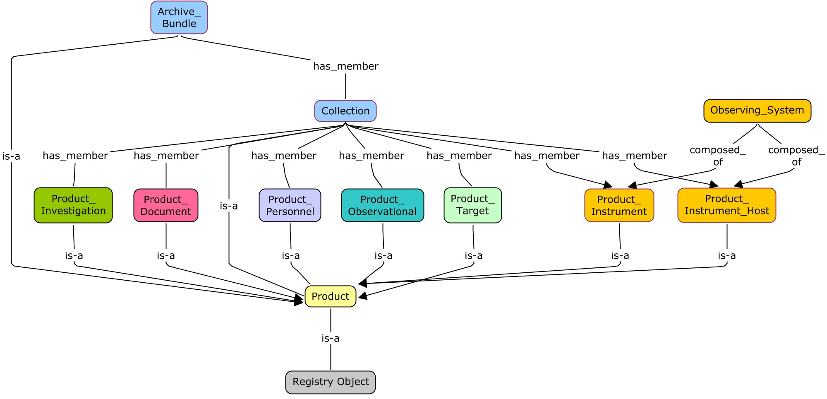
PDS4 from 10K Feet - Concept Map

Slide 8
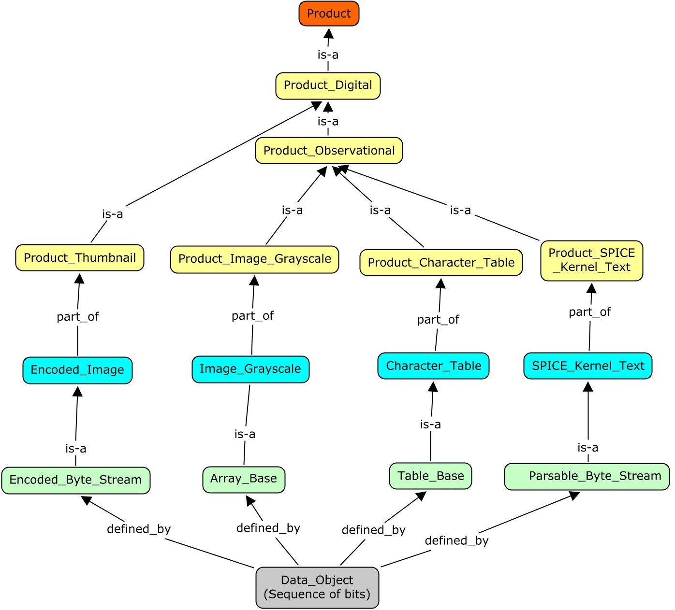
Observational Product – Concept Map

Slide 9
Class Extensions
Extensions

Slide 10
External Standards
Open Archival Information System (OAIS) Reference Model - Defines the “Information Object” a key component of the model.
ISO/IEC 11179-3: Registry Metamodel and Basic Attributes - Provides the schema for the data dictionary. Defines the concepts of registration authority and steward for governance.
Object_Oriented Data Modeling – Used as a standard modeling methodology.
XML/XML Schema – Provides the label syntax and validation mechanism.
OASIS/ebXML Registry Information Model - Provides attributes for object registration within a federated registry/repository.
ISO 15836:2009 The Dublin Core Metadata Element Set – Provides standard web resource identification attributes.
Semantics - RDF, RDFS, OWL - Provides W3C standards for knowledge representation.

Slide 11
Information Modeling Tool
Requirements & Domain Knowledge
PDS4 Information Model and Generated Documents
PDS4 Information Model
PDS4 Data Dictionary (ISO/IEC 11179)
Filter and Translator
XML Schema
(Generic)
Query Models
PDS4 Data Dictionary
(Doc and DB)
Registry Configuration Parameters
XML Schema
(Specific)
Information Model Specification
XML Document (Label)
XMI/UML

Slide 12
Acknowledgements*
Ed Bell
Richard Chen
Dan Crichton
Amy Culver
Patty Garcia
Ed Grayzeck
Ed Guinness
Mitch Gordon
Sean Hardman
Lyle Huber
Steve Hughes
Chris Isbell
Steve Joy
Ronald Joyner
Debra Kazden
Todd King
Joe Mafi
Mike Martin
Thomas Morgan
Lynn Neakrase
Paul Ramirez
Anne Raugh
Elizabeth Rye
Boris Semenov
Dick Simpson
Susie Slavney
* Anyone who sat through a DDWG 2-hour telecon or provided useful input.

Slide 13
Thank You

Slide 14
Backup

Slide 15
Mission Support
Mission Support – Prepare standards and tools for product design
Phobos SRM – Middle 2011
Maven – Late 2011
LADEE – Early 2012
EXOMARS – 2013

Slide 16
Product
Identification_Area
[1]
[1]
Subject_Area
[0..*]
Name_Resolution
[1]
Cross_Reference_Area
[0..*]
Bibliographic_Reference
[1..*]
Observing_System
[0..*]
Product_Reference_Entry
[1]
Observation_Area
Mission_Area
[0..*]
[0..*]
Node_Area
[1]
File_Area
[1]
Data_Area
[0..*]
Data_Area_Alternate

Slide 17
Core Products
+ Product
+ + Product_Digital
+ + + Product_Collection
+ + + + Collection_Browse
+ + + + Collection_Calibration
+ + + + Collection_Context
+ + + + Collection_Data
+ + + + Collection_Document
+ + + + Collection_Geometry
+ + + + Collection_Miscellaneous
+ + + + Collection_SPICE
+ + + + Collection_Secondary
+ + + + Collection_XML_Schema
+ + + Product_Document
+ + + Product_Manifest
+ + + + Delivery_Manifest
+ + + + Package
+ + + Product_Miscellaneous
+ + + + Product_Browse
+ + + + Product_Text_File
+ + + + Product_Thumbnail
+ + + Product_Observational
+ + + + Product_Generic
+ + + + Product_Image_Grayscale
+ + + + Product_Image_3D
+ + + + Product_Movie
+ + + + Product_Spectrum_3D
+ + + + Product_Stream_Delimited
+ + + + Product_Table_Binary
+ + + + Product_Table_Character
+ + + + Product_SPICE_Kernel_Binary
+ + + + Product_SPICE_Kernel_Text
+ + Product_NonDigital
+ + + Product_Bundle
+ + + + Archive_Bundle
+ + + Product_Instrument
+ + + Product_Instrument_Host
+ + + Product_Investigation
+ + + Product_Node
+ + + Product_PDS_Affiliate
+ + + Product_PDS_Guest
+ + + Product_Resource
+ + + Product_Target

Slide 18
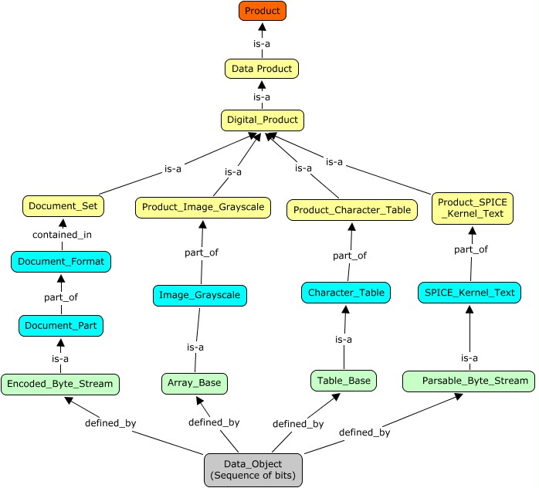
Title
Description
Subject_Area
Logical Identifier
Version Identifier
(LIDVID)
Information Object

Slide 19
Document Overview
The PDS4 Data Standards are derived from the PDS4 Information Model
The standards are documented in the Standards Reference and the Data Dictionary documents.
Generated XML Schemas are used to create and validate XML product labels.
Documents that support the data preparer while preparing data for the PDS archive include the Data Preparers Handbook, Proposer’s Archiving Guide, Archive Preparation Guide and tutorial material.

Slide 20
Standards Reference
The document is to be used in conjunction with other Planetary Data System publications:
Archive Preparation Guide - a brief overview of the archiving process
Data Provider’s Handbook - an introduction and basic “how to” manual for archiving data with the Planetary Data System
Planetary Science Data Dictionary - contains definitions of the standard classes and attributes used to describe PDS data
Proposer’s Archiving Guide - provides basic information on the archiving process (including PDS expectations) to scientists proposing for NASA planetary programs
PDS Policies and Processes
Tutorial Material

Slide 21
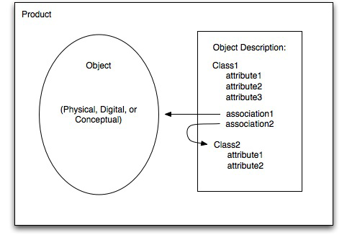
Standards Reference
The PDS4 Standards Reference document is intended primarily to serve as a reference document detailing PDS standards used in the preparation of PDS compliant data.
Documents the data standard requirements
Serves the community of scientists and engineers responsible for preparing planetary science data sets for submission to the PDS.
Status: Alpha version released; Appendix in sync with PDS4 information model; text being updated

Slide 22
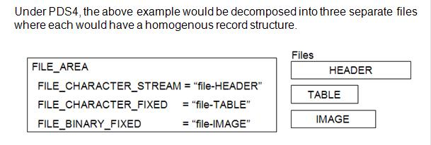
Data Providers Handbook
The Data Providers Handbook (DPH) is a guide for preparation of data being submitted to the Planetary Data System (PDS).
The DPH functions in the capacity of a tutor/coach to provide information and examples to guide data providers in the design and preparation of data to be archived with the PDS.
Status: Beta version released; Examples in sync with PDS4 information model; text going through third revision

Slide 23
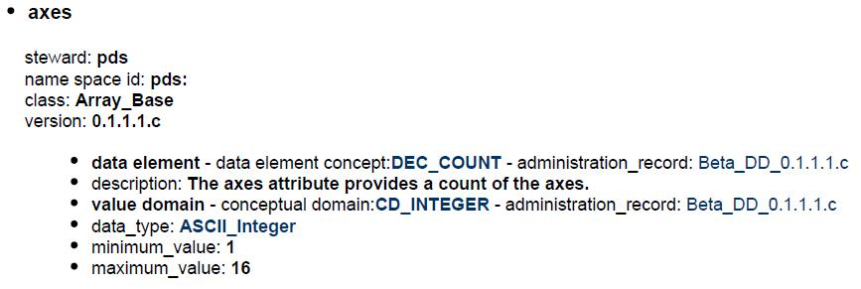
Data Dictionary
The PDS4 Data Dictionary defines the organization and components of PDS4 product labels.
Classes - A template from which individual members may be constructed – E.g., Image_Grayscale and Table_Character.
Attributes – A property or characteristic that provides a unit of information about a class. – E.g., axes and fields.
Status: Beta version released; contents in sync with PDS4 information model

Slide 24
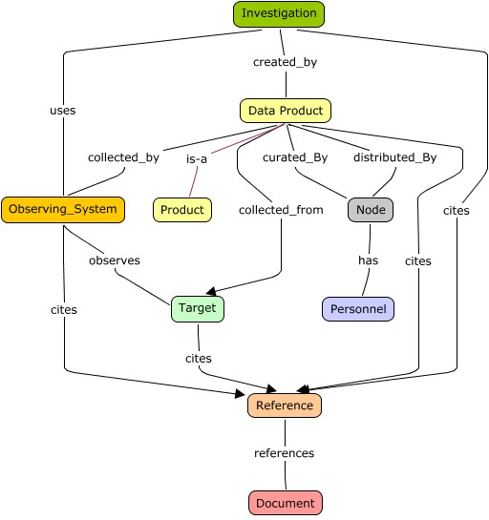
Information Model Specification
PDS4 Information Model Specification document defines the components of the PDS Data Standards.
Intended for use by programmers and data engineers who require formal definitions of various parts of the PDS.
Defines all classes in use in the PDS
Archival elements
Context descriptions
Operational support
Defines associations among classes
Status: Beta version released;
Contents in sync with PDS4
information model

Slide 25
XML Schema
An XML schema is a description of a type of XML document.
Used to create and validate XML documents (aka PDS4 Product Labels)
The PDS4 information model is implemented into XML schemas.
Status: Beta version released; In sync with PDS4 information model
<xsd:complexType name="Image_Grayscale_Type">
<xsd:sequence>
<xsd:annotation>
<xsd:documentation>
The Image Grayscale class is an extension of array_base and defines
a two dimensional grayscale image.
</xsd:documentation>
</xsd:annotation>
<xsd:element name="comment" type="pds:comment_Type" minOccurs="0" maxOccurs="1">
<xsd:element name="axes" type="pds:Array_2D_axes_Type" minOccurs="1" maxOccurs="1">
<xsd:element name="axis_order" type="pds:Image_Grayscale_axis_order_Type" minOccurs="1"
<xsd:element name="encoding_type" type="pds:Array_Base_encoding_type_Type" minOccurs="1"
<xsd:element name="Data_Location" type="pds:Data_Location_Type" minOccurs="1" maxOccurs="1">
<xsd:element name="Array_Axis" type="pds:Array_Axis_Type" minOccurs="2" maxOccurs="2">
<xsd:element name="Array_Element" type="pds:Array_Element_Type" minOccurs="1" maxOccurs="1">
</xsd:sequence>
<xsd:attribute name="base_class" type="xsd:string" fixed="Array_Base"> </xsd:attribute>
</xsd:complexType>

Slide 26
Product Labels
Generic XML schema are used as building blocks to create a specific XML schema for a particular product.
An XML document (aka Product Label) is created from and validated by the specific XML schema.
<Image_Grayscale base_class="Array_Base">
<comment>-comment-</comment>
<axes>2</axes>
<axis_order>FIRST_INDEX_FASTEST</axis_order>
<encoding_type>Binary</encoding_type>
<Data_Location>
<file_local_identifier>-local_identifier-</file_local_identifier>
<offset>-0-</offset>
</Data_Location>
<Array_Axis>
<elements>-800-</elements>
<name>-name-</name>
<sequence_number>-0-</sequence_number>
<unit>-unit-</unit>
</Array_Axis>
…
<Array_Element>
<data_type>-data_type-</data_type>
<unit>-unit-</unit>
</Array_Element>
</Image_Grayscale>

