Slide 1
PDS4 From Model to XML: A Label’s Journey
J. Mafi, T. King, S. Joy, D. Kazden, E. Guinness

Slide 2
PDS4 Documents and their Relationships
Concepts
Document
Data Dictionary
Tutorial
Big Picture
Informative
Standards
Reference
Data Provider’s
Handbook
references
Requirements
User Friendly
Cookbook
references
derive
generates
instruct
PDS4 Information
Model Specification
Data Dictionary
generates
Requirements
Engineering Specification
Definitions
generates
XML Schemas
PDS4
Product Labels
generates
creates /
validates
Blueprints
Deliverables
Legend
Informative
Document
Registry
Configuration File
Registry
Standards
Document
configures
File
Object Descriptions
Product Tracking and Cataloging
System

Slide 3
From Model to Label
MODEL
SCHEMA
LABEL

Slide 4
PDS4 Information Model
“defines all classes in use in the PDS, including those classes used to define archival elements as well as classes used for high-level descriptions and operational support” (from PDS 4 Information Model Specification)
Implementation agnostic
Reflects design of Data Design Working Group (DDWG)
Maintained by Engineering Node (EN)

Slide 5
Schema (XML)
“definition of an XML document, specifying required and optional XML elements, their order, and parent-child relationships.” (from D. Simpson, Glossary of PDS4 Terms)
XML implementation of an element of the PDS4 Information Model
Three types:
Generic: full implementation of IM
Tailored: generic schema augmented by additional namespaces
Specific: constrained implementation of schema for a particular product

Slide 6
Generic Schema
Generated from the PDS4 Information Model
Element attributes defined by the Model
Managed by EN
Available online at: http://pds.nasa.gov/schema/pds4/common
Downloadable
Allows verification of the generic elements in the label

Slide 7
Generic Schema
Generic
SCHEMA
LABEL
MODEL
PRODUCT

Slide 8
Tailored Schema
Extension of generic schema by addition of other namespaces
Additional utility reflects specific discipline and/or project needs
Discipline node schema
Mission schema

Slide 9
Tailored Schema
Generic
SCHEMA
MODEL
Tailored
SCHEMA
LABEL
Local
SCHEMA
Local
MODEL
PRODUCT

Slide 10
Local Schema: Discipline Classes
Geo
Metadata to support search tools
Map projections
Imaging
Coordinate System
Camera Model
Camera Parameters
Telemetry Parameters
Map projections
Coefficients Array
PPI
Metadata to support SPASE searches
Rings
Ring geometry
Ring occultation
Info supporting footprint diagrams
EN
Data Quality
Provenance
RS
International Celestial Reference System
Earth Mean Equator and Dynamic Equinox of J2000.0
Earth Mean Equator and Dynamic Equinox of J2000.0
Ecliptic Coordinates based on the EME-E 2000 frame
Planetocentric (body-fixed) for all solar system bodies (referenced to fixed surface features)
Planetocentric (body-fixed) for all solar system bodies (referenced to principal axes of inertia)
Planet true equator/equinox of date ITRF92, 93, … 08

Slide 11
Specific Schema
Constraint of generic or tailored schema for a specific type of product
Managed by discipline node
Must still validate under generic or tailored schema

Slide 12
Specific Schema
Generic
SCHEMA
MODEL
Tailored
SCHEMA
LABEL
Local
SCHEMA
Local
MODEL
PRODUCT

Slide 13
Labels
Instantiation of the generic, tailored, or specific schema to describe a digital or non-digital object
Implemented in XML
May be validated against the schema using off-the-shelf software

Slide 14
So what does this have to do with cows?

Slide 15
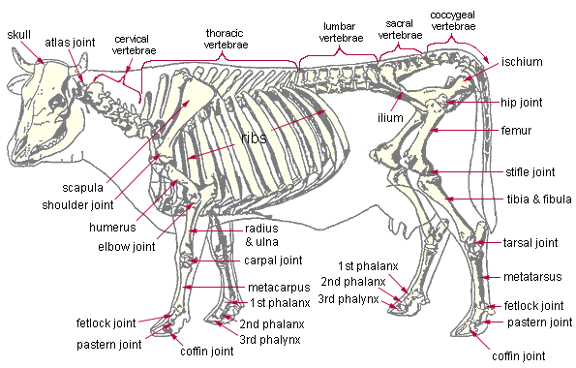
Model Cow

Slide 16
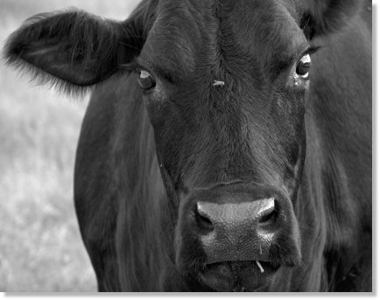
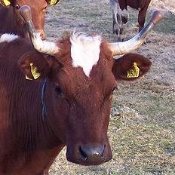
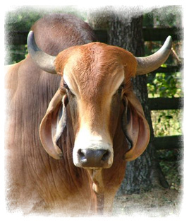
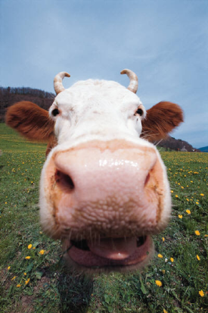
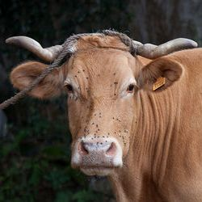
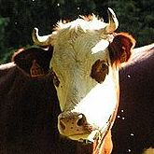
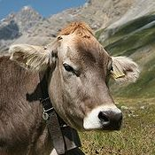
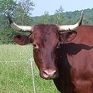
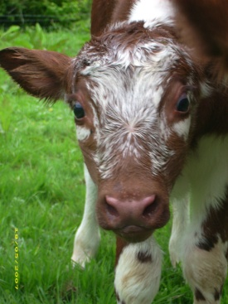
Generic Product_Cow Schema

Slide 17
Tailored Product_Cow Schema
<complexType name=“Cow_Type”>
<element name=“horns” type=“horns_Type” minOccurs=“0” maxOccurs=“1”></element>
<element name=“cow_happy” type=“ppi:cow_happy_Type” minOccurs=“1” maxOccurs=“1”></element>
</complexType>
<complexType name=“Horns_Type”>
<element name=“horn_length” type=“horn_length_Type” validMin=“0” validMax=“200” unit=“cm”></element>
</complexType>

Slide 18
Specific Product_Cow Schema

Slide 19
Specific Product_Cow Schema
From Generic Product_Cow:
<complexType name=“Cow_Type”>
<element name=“horns” type=“Horns_Type” minOccurs=“0” maxOccurs=“1”>
</element>
</complexType>
<complexType name=“Horns_Type”>
<element name=“horn_length” type=“horn_length_Type” validMin=“0” validMax=“200” unit=“cm”></element>
</complexType>
From Specific Product_Cow:
<complexType name=“Cow_Type”>
<element name=“horns” type=“horns_type” minOccurs=“1” maxOccurs=“1”>
</element>
</complexType>
<complexType name=“Horns_Type”>
<element name=“horn_length” type=“horn_length_Type” validMin=“0” validMax=“40” unit=“cm”>
</complexType>

Slide 20
Example Process:
Product_Table_Character

Slide 21
The Product
Voyager 1 PLS at Jupiter: Ion Density Moments
Fixed width ASCII table
Single header row

Slide 22
The Data
“SPACECRAFT_EVENT_TIME”, “ION_DENSITY_MOM”
1979-03-01T12:04:12.474 8.82e-03
1979-03-01T12:05:48.474 1.00e-02
1979-03-01T12:07:24.474 7.69e-03
1979-03-01T12:09:00.474 1.12e-02
1979-03-01T12:10:36.474 1.19e-02
1979-03-01T12:12:12.474 9.47e-03
1979-03-01T12:13:48.474 6.83e-03
1979-03-01T12:15:24.474 7.68e-03
. .
. .
. .

Slide 23
Data Product Classes
Identification_Area [1]
Cross_Reference_Area [1]
Observation_Area [1]
File_Area [1…*]
Data_Area [1]
Data_Area_Alternate [0..*]

Slide 24
Data Product Classes
Identification_Area [1]
Cross_Reference_Area [1]
Observation_Area [1]
File_Area [1…*]
Data_Area [1]
Data_Area_Alternate [0..*]
high-level product description information
Unique identifier: “LID”
Used to register product
Version ID
Title
Subject_Area [1]
Human readable / searchable product keywords

Slide 25
Data Product Classes
Identification_Area [1]
Cross_Reference_Area [1]
Observation_Area [1]
File_Area [1…*]
Data_Area [1]
Data_Area_Alternate [0..*]
LID references to associated products
Bibliographic reference [0…*]
Observing system [1]
Instrument host
Instrument
Other products [0]:
Browse
Calibration
SPICE
Target

Slide 26
Data Product Classes
Identification_Area [1]
Cross_Reference_Area [1]
Observation_Area [1]
File_Area [1…*]
Data_Area [1]
Data_Area_Alternate [0..*]
Circumstances under which data were collected
Start/stop time
Other mission or node specific information

Slide 27
Data Product Classes
Identification_Area [1]
Cross_Reference_Area [1]
Observation_Area [1]
File_Area [1…*]
Data_Area [1]
Data_Area_Alternate [0..*]
Information on the labeled files
Creation time [0]
File name [1]
File size [0]
Max record bytes [0]
MD5 checksum [0]
Records [0]

Slide 28
Data Product Classes
Identification_Area [1]
Cross_Reference_Area [1]
Observation_Area [1]
File_Area [1…*]
Data_Area [1]
Data_Area_Alternate [0..*]
Data structure info (for Product_Table_Character)
Encoding type [1]
Fields [1]
Record bytes [1]
Records [1]
Data location [1]
Record structure info [1…*]
Field info [1…*]

Slide 29
Data Product Classes
Identification_Area [1]
Cross_Reference_Area [1]
Observation_Area [1]
File_Area [1…*]
Data_Area [1]
Data_Area_Alternate [0..*]
Allows inclusion of additional data objects (e.g. header)

Slide 30
http://pds.nasa.gov/schema/pds4/generic/common
Archive_Bundle_0200B.xsd
Base_Types_0200d.xsd
Collection_Browse_0200d.xsd
Collection_Calibration_0200d.xsd
Collection_Context_0200d.xsd
Collection_Data_0200d.xsd
Collection_Document_0200d.xsd
Collection_Generic_0200d.xsd
Collection_Miscellaneous_0200d.xsd
Collection_SPICE_0200d.xsd
Collection_Secondary_0200d.xsd
Collection_XML_Schema_0200d.xsd
Data_Dict_commpds3_0200d.xsd
Delivery_Manifest_0200d.xsd
Extended_Types_0200d.xsd
Header_0200d.xsd
Image_3D_0200d.xsd
Image_Grayscale_0200d.xsd
Local_DD_0200d.xsd
Product_Browse_0200d.xsd
Product_Bundle_0200d.xsd
Product_Document_0200d.xsd
Product_Element_Definition_0200d.xsd
Product_Generic_0200d.xsd
Product_Image_Grayscale_0200d.xsd
Product_Instrument_0200d.xsd
Product_Instrument_Host_0200d.xsd
Product_Investigation_0200d.xsd
Product_Mission_0200d.xsd
Product_Node_0200d.xsd
Product_PDS_Affiliate_0200d.xsd
Product_PDS_Guest_0200d.xsd
Product_Resource_0200d.xsd
Product_SPICE_Kernel_Binary_0200d.xsd
Product_SPICE_Kernel_Text_0200d.xsd
Product_Stream_Delimited_0200d.xsd
Product_Table_Binary_0200d.xsd
Product_Table_Binary_Grouped_0200d.xsd
Product_Table_Character_0200d.xsd
Product_Table_Character_Grouped_0200d.xsd
Product_Target_0200d.xsd
Product_Text_File_0200d.xsd
Product_Thumbnail_0200d.xsd
Product_XML_Schema_0200d.xsd
Product_Zipped_0200d.xsd
SPICE_Kernel_Binary_0200d.xsd
SPICE_Kernel_Text_0200d.xsd
Schema_0200d.zip
Spectrum_2D_0200d.xsd
Spectrum_3D_0200d.xsd
Stream_Delimited_0200d.xsd
Table_Binary_0200d.xsd
Table_Character_0200d.xsd

Slide 31
http://pds.nasa.gov/schema/pds4/generic/common
Archive_Bundle_0200B.xsd
Base_Types_0200d.xsd
Collection_Browse_0200d.xsd
Collection_Calibration_0200d.xsd
Collection_Context_0200d.xsd
Collection_Data_0200d.xsd
Collection_Document_0200d.xsd
Collection_Generic_0200d.xsd
Collection_Miscellaneous_0200d.xsd
Collection_SPICE_0200d.xsd
Collection_Secondary_0200d.xsd
Collection_XML_Schema_0200d.xsd
Data_Dict_commpds3_0200d.xsd
Delivery_Manifest_0200d.xsd
Extended_Types_0200d.xsd
Header_0200d.xsd
Image_3D_0200d.xsd
Image_Grayscale_0200d.xsd
Local_DD_0200d.xsd
Product_Browse_0200d.xsd
Product_Bundle_0200d.xsd
Product_Document_0200d.xsd
Product_Element_Definition_0200d.xsd
Product_Generic_0200d.xsd
Product_Image_Grayscale_0200d.xsd
Product_Instrument_0200d.xsd
Product_Instrument_Host_0200d.xsd
Product_Investigation_0200d.xsd
Product_Mission_0200d.xsd
Product_Node_0200d.xsd
Product_PDS_Affiliate_0200d.xsd
Product_PDS_Guest_0200d.xsd
Product_Resource_0200d.xsd
Product_SPICE_Kernel_Binary_0200d.xsd
Product_SPICE_Kernel_Text_0200d.xsd
Product_Stream_Delimited_0200d.xsd
Product_Table_Binary_0200d.xsd
Product_Table_Binary_Grouped_0200d.xsd
Product_Table_Character_0200d.xsd
Product_Table_Character_Grouped_0200d.xsd
Product_Target_0200d.xsd
Product_Text_File_0200d.xsd
Product_Thumbnail_0200d.xsd
Product_XML_Schema_0200d.xsd
Product_Zipped_0200d.xsd
SPICE_Kernel_Binary_0200d.xsd
SPICE_Kernel_Text_0200d.xsd
Schema_0200d.zip
Spectrum_2D_0200d.xsd
Spectrum_3D_0200d.xsd
Stream_Delimited_0200d.xsd
Table_Binary_0200d.xsd
Table_Character_0200d.xsd

Slide 32
Required Generic Schema
Base_Types_0200d.xsd – class and element definitions, standard values, value format, valid range, etc.
Extended_Types_0200d.xsd – class and element definitions, standard values, value format, valid range, etc.
Header_0200d.xsd – header description class
Product_Table_Character_0200d.xsd – ASCII table description class

Slide 33
Creating a Tailored Schema: Tools
XML editor
Allows immediate validate of schema
A lot of options (including free versions):
Eclipse
Oxygen
Editix
Text Editor

Slide 34
Creating a Tailored Schema: Process
Generic Schema
Tailored Schema
Identification_Area [1]
Cross_Reference_Area [1]
Observation_Area [1]
File_Area [1…*]
Data_Area [1]
Data_Area_Alternate [0..*]
Identification_Area [1]
Cross_Reference_Area [1]
Observation_Area [1]
File_Area [1…*]
Data_Area [1]
Data_Area_Alternate [1]
Header [1]

Slide 35
Generate Blank XML
Tools:
XML editor
Much simpler to convert schema to XML
Allows immediate validation of XML
Process
XML editor
Push a button
XML editor behavior will vary

Slide 36
Backup Slides

Slide 37
Creating a Tailored Schema: Process
<xsd:complexType name="Data_Area_Alternate_Type">
<xsd:sequence>
<xsd:annotation>
<xsd:documentation>
The Data Area Alternate allows the inclusion of any Data Object Description.
</xsd:documentation>
</xsd:annotation>
<!-- When creating a specific XML schema, remove the 'xsd:any' element. You may insert any described data object, one or more times. -->
<xsd:any minOccurs="0"/>
<!-- <xsd:element name="Any_Data_Object" type="pds:Any_Data_Object_Type" minOccurs="0" maxOccurs="unbounded"> </xsd:element> -->
</xsd:sequence>
</xsd:complexType>

Slide 38
Creating a Tailored Schema: Process
<xsd:complexType name="Data_Area_Alternate_Type">
<xsd:sequence>
<xsd:annotation>
<xsd:documentation>
The Data Area Alternate allows the inclusion of any Data Object Description.
</xsd:documentation>
</xsd:annotation>
<!-- When creating a specific XML schema, remove the 'xsd:any' element. You may insert any described data object, one or more times. -->
<xsd:any minOccurs="0"/>
<!-- <xsd:element name="Any_Data_Object" type="pds:Any_Data_Object_Type" minOccurs="0" maxOccurs="unbounded"> </xsd:element> -->
</xsd:sequence>
</xsd:complexType>

Slide 39
Creating a Tailored Schema: Process
<xsd:complexType name="Data_Area_Alternate_Type">
<xsd:sequence>
<xsd:annotation>
<xsd:documentation>
The Data Area Alternate allows the inclusion of any Data Object Description.
</xsd:documentation>
</xsd:annotation>
<!-- When creating a specific XML schema, remove the 'xsd:any' element. You may insert any described data object, one or more times. -->
<xsd:element name="Header" type="pds:Header_Type" minOccurs="1" maxOccurs="1"> </xsd:element>
</xsd:sequence>
</xsd:complexType>

Slide 40
Creating a Tailored Schema: Process
<xsd:complexType name="Header_Type">
<xsd:sequence>
<xsd:annotation>
<xsd:documentation>
The Header class describes a data object header.
</xsd:documentation>
</xsd:annotation>
<xsd:element name="local_identifier”> </xsd:element>
<xsd:element name="comment”> </xsd:element>
<xsd:element name="description”> </xsd:element>
<xsd:element name="bytes"> </xsd:element>
<xsd:element name="encoding_type"> </xsd:element>
<xsd:element name="external_standard_id“></xsd:element>
<xsd:element name="name" > </xsd:element>
<xsd:element name="Data_Location"> </xsd:element>
</xsd:sequence>
</xsd:complexType>

Slide 41
Creating a Tailored Schema: Process
<xsd:element name="Header" type="pds:Header_Type">
<xsd:annotation>
<xsd:documentation>
The Header XML Schema
</xsd:documentation>
</xsd:annotation>
</xsd:element>

Slide 42
XML Schema Definition
<Product_Table_Character xsi:schemaLocation="http://pds.nasa.gov/schema/pds4/pds http://pds.nasa.gov/schema/pds4/generic/common/Product_Table_Character_0200d.xsd" xmlns="http://pds.nasa.gov/schema/pds4/pds" xmlns:xsi="http://www.w3.org/2001/XMLSchema-instance">

Slide 43
XML: Identification_Area
<Identification_Area_Product>
<logical_identifier>VALUE</logical_identifier>
<version_id>VALUE</version_id>
<product_class>VALUE</product_class>
<title>VALUE</title>
<Subject_Area/>
</Identification_Area_Product>

Slide 44
XML: Cross_Reference_Area
<Cross_Reference_Area_Product>
<Observing_System>
<title>VALUE</title>
<Observing_System_Component>
<observing_system_component_type/>
<Observing_System_Reference_Entry>
<reference_association_type/>
</Observing_System_Reference_Entry>
</Observing_System_Component>
</Observing_System>
</Cross_Reference_Area

Slide 45
XML: File_Area
<File_Area>
<File>
<local_identifier>VALUE</local_identifier>
<file_name>VALUE</file_name>
</File>
</File_Area>

Slide 46
XML: Observation_Area
<Observation_Area>
<start_date_time>VALUE</start_date_time>
<stop_date_time>VALUE</stop_date_time>
</Observation_Area>

Slide 47
XML: Data_Area
<Data_Area_Table_Character>
<Table_Character>
<local_identifier>VALUE</local_identifier>
<encoding_type>VALUE</encoding_type>
<fields>VALUE</fields>
<record_bytes>VALUE</record_bytes>
<records>VALUE</records>
<Data_Location>
<file_local_identifier>VALUE</file_local_identifier>
<offset>VALUE</offset>
</Data_Location>
<Table_Record_Character>
<Table_Character_Field>
</Table_Character_Field>
</Table_Record_Character>
</Table_Character>
</Data_Area_Table_Character>

Slide 48
XML: Data_Area_Alternate
<Data_Area_Alternate>
<Header>
<local_identifier/>
<bytes/>
<encoding_type/>
</Header>
</Data_Area_Alternate>

