Slide 1
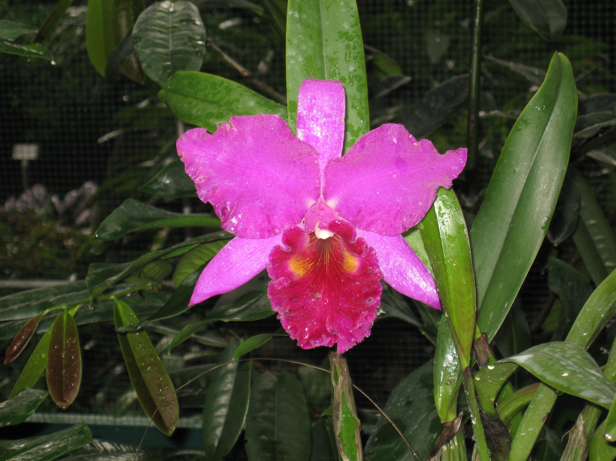
Meeting with Kaguya team at AOGS
Attendees: Masaki Nishino, Yoshifumi Saito, Yukio Yamamoto, Shoichiro Yokata, Ray Walker
Still some concern over complexity of the PDS metadata.
Selene data base is still being developed.
Some PIs still not convinced they should provide complete archive – will make level 3 and 4 data level products available.
Will start with PACE and MAG data.
Raw data and level 1 data ready.
Still creating level 2 PACE data as CDF
Level 3 and 4 data coming.
Information necessary to design data products to Mark Sharlow in two weeks.
Nishino is the contact person.

