Slide 1
PDS Engineering Node (EN) B12. 1 Delivery & Deployment Review
Gary Chen, John Engelke,
Richard Chen, Vivian Tang
Thomas Loubrieu, Jordan Padams
May 23, 2021

Slide 2
Agenda
Review Board
Software Overview
Work Product Status
Requirements
Improvements
Defect Corrections
Test Status Summary
Test Case Explanation(s)
Unverified Requirements
Unverified Improvements
Unverified Defect Corrections
Software Status
Open Defect Summary
Open CRIT 1 & 2 Defects
Action Item Status
Deviation Summary
Deviations
Waivers & Liens
ECRs
Other
Backup
Test Objectives
Test Environment
Key Test Cases

Slide 3
Review Board
Chair | Robin O’Brien
Chief Engineer | Costin Radulescu
Assurance Engineer | Eva Bokor
Security Systems Engineer | Mike Pajevski
Task Manager | Jordan Padams
Task Cognizant Engineer | Thomas Loubrieu
Board
Customers
N/A – PDS EN will present an overview of these
slides to PDS Software Working Group

Slide 4
Software Overview
The Planetary Data System (PDS) is NASA’s official planetary data long term archive.
For more information on the PDS, see our website: https://pds.nasa.gov/home/about/
In addition to PDS website, PDS Engineering Node is responsible for PDS4, PDS Information Model, and a suite of PDS4 system services and tools that support PDS data lifecycle.
For more information on the PDS Engineering Node, see our website: https://pds-engineering.jpl.nasa.gov/
Build 12.1 made a number of improvements for Information Model 1.18.0 and tools including
Registry App, DOI Service, Deep Archive, Validate
In addition, it fixed a number issues found in previous builds.

Slide 5
Known Issues
The following known details are missing from the review material:
Section | Description | Status
Improvements and Bug Counters | Our current reporting mechanisms enable autonomous counters for issue tracking during the build cycle. Issues raised during the I&T will be implemented in the upcoming delivery. | In progress
SLOC Counts | We began to collect SLOC and are working on a stable procedure and reporting. | In progress
Code Coverage | We currently do not have code coverage for our repositories. | Not started
Requirement Traceability | We currently do not have requirement mapping for our releases. | Not started

Slide 6
Work Product Status
Document Title | DMS Doc and Revision ID
Management Plan | https://pds-eng ineering.jpl.nasa.gov/sites/default/files/documents/pds2010/keydocuments/PDS-SMP.pdf
Task Implementation Plan | https://pds-engineering.jpl.nasa.gov/sites/default/files/documents/pds2010/pds4-proj-plan-07172013.pdf
Release Plan | https://nasa-pds.github.io/releases/12.1/plan.html
Operation Concept | https://pds-engineering.jpl.nasa.gov/sites/default/files/documents/pds2010/keydocuments/pds4-ops-concept.pdf
Requirements | https://pds-engineering.jpl.nasa.gov/sites/default/files/documents/pds2010/design/system_design/pds4_system_reqs.pdf
Architecture Description | https://pds-engineering.jpl.nasa.gov/sites/default/files/documents/pds2010/architecture/system_architecture/pds4_system_arch_spec.pdf
Design Specification | See various design docs in: https://pds-engineering.jpl.nasa.gov/content/key-documents
Interface Specification | N/A
Test Plan | https://pds-engineering.jpl.nasa.gov/file/release_build_12.1_test_plan.v6.20220407.pdf
Test Procedures | https://pds-engineering.jpl.nasa.gov/file/build12.0testprocs.pdf
Release Description | https://nasa-pds.github.io/releases/12.0/rdd.html
Product Guide | N/A
User Guide | See individual tool documentation. Links in RDD
Test Report | https://pds-engineering.jpl.nasa.gov/file/build12.1testprocs_v10.pdf

Slide 7
Test Status Summary
Metric | Value
Total Number of Tests | 127
Successful Tests | 123
Partially Successful Tests | 2
Tests in Progress | 0
Unsuccessful Tests | 2
Unexecuted Tests | 0

Slide 8
Improvements
Summary of Significant Improvements
Registry/API: API v1.0 with more response formats, documentation, dockerization, deployment of 7 production registries on AWS
Information Model: Refactoring of IMTool, experimentation with graph database
Validate: PDF/A validation and integrity constraint verification improvements
DOI Service: transition to production to mint DOIs command line, synchronization with alternate PDS DOI providers, DOI UI deployed for demo.
Web Portal: migration on AWS
Devops: started continuous deployment with Jenkins
Total number of new improvements | 58
For requirements tracing, see tickets.
To view all bugs, see RDD: https://nasa-pds.github.io/releases/12.1/rdd.html

Slide 9
Defect Corrections
Summary of Significant Defect Fixes
Validate: security log4j, PDF/A file not validated in subdirectories
Deep archive: unexpected error when running on a valid bundle
Harvest: improved robustness (3 high severity bugs fixed)
Total number of closed defects | 94
For requirements tracing, see tickets.
To view all bugs, see RDD: https://nasa-pds.github.io/releases/12.1/rdd.html

Slide 10
Requirements
ID | Requirement Statement | Procedure Test ID | Requester
1 | PDS Registry API | REG-API.* | PDS
2 | PDS DOI Service | DOI.* | PDS
3 | PDS Deep Archive | DEEP.* | PDS
4 | Validate | VAL.* | PDS
5 | PDS4 Information Model | IM.* | PDS
6 | PLAID | PLAID.* | PDS
7 | PDS-API | API.* | PDS
8 | PDS DOI UI | DOI-UI.* | PDS
9 | PDS Registry APP | REG-APP.* | DPS
10 | PDS-WDS-REACT | WDS.* | PDS
Total number of new requirements | 37

Slide 11
Failed Test Case 1
Test Case DOI-UI.4
Description: Fix DOI Search And DOI UI Integration Bugs.
Result: Partial Fail
Severity: Medium
Issues:
If the user switches between “Home” & “Search” buttons multiple times without doing anything else, then the style of the page starts to fail.
Associated Issues:
https://github.com/NASA-PDS/doi-ui/issues/117
https://github.com/NASA-PDS/doi-ui/issues/132
Notes:
just needed to wrap the LID in quotes. This could be clarified in the docs, and improve in the capability in the future.

Slide 12
Failed Test Case 2
Test Case API.11
Description: As a user, I want to have a detailed description of the API q parameter syntax.
Result: Partial Fail
Severity: Low
Issue:
The descriptions for “q” are correct in two of the three end-points, the description in “/Products” needs to be updated, it is still showing the simple version.
Associated Issues:
https://github.com/NASA-PDS/pds-api/issues/137

Slide 13
Failed Test Case 3
Test Case VAL.6
Description: Validate does not flag *.tab files with variable length records.
Result: Fail
Severity: Medium
Issue:
Issue not valid and to be revisited with working group, more detail in validate#229.
Validate does not flag *.tab files with variable length records.
Associated Issues:
https://github.com/NASA-PDS/validate/issues/390
https://github.com/NASA-PDS/validate/issues/491

Slide 14
Failed Test Case 4
Test IM.10
Description: CCB-335: Inventory Specification Allows Too Many Delimiters
Result: Fail
Severity: Medium
Issue:
The IM failed to set the cardinality spec strictly for the ‘Inventory.Uniformly_Sampled’ attribute which is required in CCB-335 to disallow usage.
Associated Issues:
https://github.com/NASA-PDS/pds4-information-model/issues/478

Slide 15
Unverified Requirements
All Requirements assigned to Integration and Testing have been tested.

Slide 16
Unverified Improvements
All improvements assigned to Integration and Testing have been tested.

Slide 17
Unverified Defect Corrections
All Defect corrections assigned to Integration and Testing have been tested.

Slide 18
Software Status
We began to collect SLOC and are working on a stable procedure and reporting.

Slide 19
Tested SLOC metrics (for feedback)
Application | Lines of code increase since last build | Comments
deep-archive | 10.17%
devops | 8.92%
doc | 17.53%
doi | 38.13% | ?
information model | 2.99%
mi-label | 0.17%
pds-api | 53.56% | more documentation
PLAID | 0.03%
registry | 89.68% | new scalable version
transform | -2.81%
validate | 0.93%

Slide 20
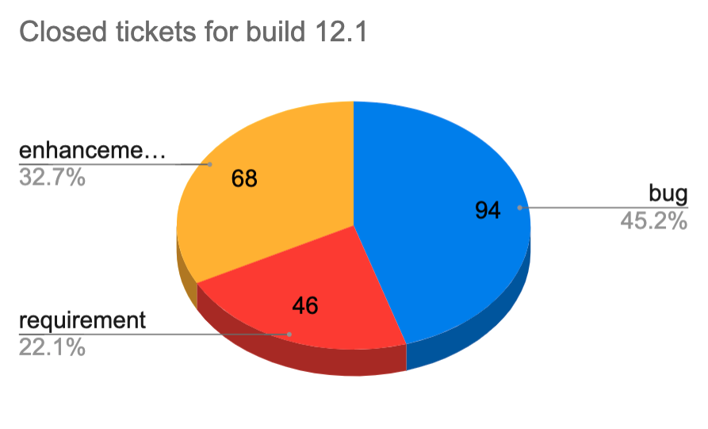
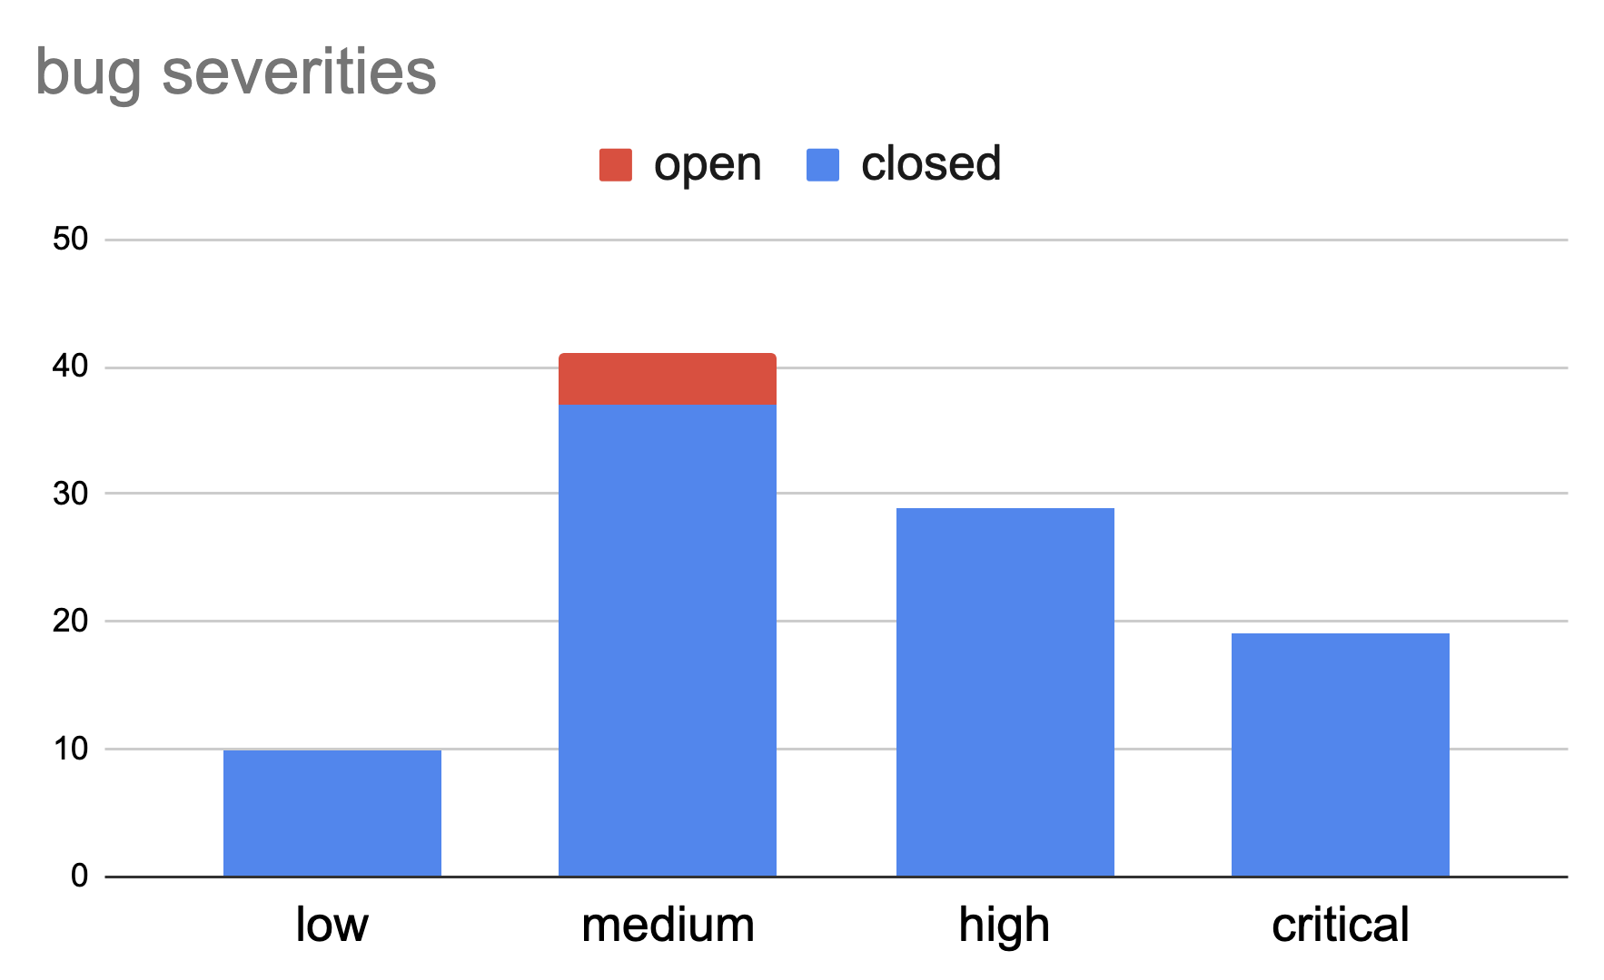
Defect Summary (before I&T)
No high or critical bugs remain open

Slide 21
I&T tickets: dev status
ref | title | created at | severity | status | Comment
doi-service#313 | Document need to be update after adding the update argument | 2022-01-05 | s.high | closed
doi-ui#93 | pds-doi-ui does not communicate to doi-service via port 8080 | 2021-10-17 | s.medium | closed
doi-ui#132 | App bar slightly broken when DOI UI is deployed from build package with `serve` | 2022-04-18 | s.medium | open | correction done but not merged
pds-api#130 | pds api not able to search using URL parameters | 2021-11-01 | s.low | closed
pds4-information-model#170 | LDDTool: DocBook generation does not work from any file system location | 2020-04-08 | s.medium | closed
pds4-information-model#455 | PDS4_PDS_1I00.sch has two bugs regarding CCB-339 | 2022-03-19 | s.high | closed
pds4-information-model#479 | Data with illegitimate units PASS validation when it should fail | 2022-05-13 | s.medium | open | not processed yet
pds4-information-model#480 | Data Provider’s Handbook v1.18.0 is missing the Appendix F text requested in the CCB-340 | 2022-05-13 | s.medium | closed
registry#41 | docker compose int-registry-batch-loader failure | 2022-04-24 | s.medium | closed
validate#427 | validate does not work correct when path name contains a space on mac | 2021-10-25 | s.medium | open | HR challenges
validate#429 | validate warns "document standard id ... is not correct" on good labels | 2021-10-26 | s.high | closed
validate#431 | warning.table.characters_between_fields missing for last record in table | 2021-10-26 | s.low | open | HR challenges
validate#432 | Missing referential integrity checks from browse products to others in the bundle | 2021-10-26 | s.medium | open | HR challenges

Slide 22
Action Item Status
No formal Request for Actions from TRR

Slide 23
Planned Deviations
“CCB” process defined with PDS Software Working Group
See details and rational on https://github.com/NASA-PDS/pds-swg/issues?q=label%3AB12.1+label%3Achange-request

Slide 24
Deviation metrics
Components | planned | planned realized | realized | comment
cloud-tasks | 7 | 4 | 7 | web lift-and-shift is taking longer than expected
deep-archive | 1 | 1 | 1
devops | 2 | 1 | 1
doi-service | 4 | 4 | 6
pds-api | 2 | 2 | 9 | Refinement as we want to release a version 1
registry | 5 | 3 | 5 | OpenSearch migration took longer than expected
wds-react | 0 | 0 | 2 | Technical component which development started earlier for the DOI UI
web-mgmt | 3 | 3 | 3
UX/Web design | 2 | 2 | 10 | planned after beginning of the build cycle
information-model | 3 | 2 | 4 | planned after beginning of the build cycle
PLAID | 0 | 0 | 1 | security issue
validate | 5 | 2 | 2 | hr challenges
nucleus | 2 | 0 | 0 | hr challenges
other | 3 | 3 | 3

Slide 25
Review Board

Slide 26
Backup

