Slide 1
PDS4 DDWG Status Report
PDS MC Face-to-Face
2017-04-20
Mitch Gordon and Ron Joyner

Slide 2
DDWG2 Overview
The DDWG now –
Provides the administrative oversight of the SCR process leading to the CCB.
Finding solutions to problems identified in SCRs, is done by Tiger Teams.
For each new SCR, the DDWG provides a Priority, estimates the expected level of Effort, determines the Type, the Target Build, and identifies Tiger Team members by node.
Met: March 9th, 23rd, April 9th.
Next: April 27th
PDS google drive or equivalent?

Slide 3
SCRs (1)
20 SCRs
8 Actively being worked
4 Projected for next week’s telecon
6 “in the queue” (waiting for a telecon)
2 “on hold” (dependent on outcome of another SCR)

Slide 4
Node participation
‘Node’ | Lead | TT | Total
ATM | 1 | 2 | 3
CIS | 1 | 4 | 5
EN | 2 | 6 | 8
GEO |  | 4 | 4
IPDA |  | 2 | 2
PPI |  | 4 | 4
RMS | 2 |  | 2
RS |  | 1 | 1
SBN | 4 | 2 | 6

Slide 5
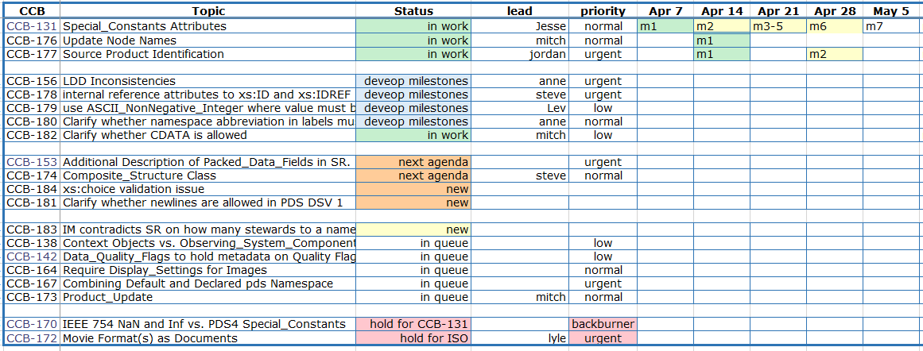
SCR Tracking

Slide 6
DDWG Members
ATM Lyle Huber NAIF Boris Semenov
CIS Jordan Padams PPI Joe Mafi
EN Steve Hughes RS Dick Simpson
GEO Edward Guinness [Alt chair] RMS Mitch Gordon [chair]
IPDA Tanya Lim SBN Anne Raugh
Ron Joyner [coordinator] NSSDC Stephanie McLaughlin [observer]
Debra Kazden [reporter] PM Maria Banks [observer]
Sean Hardman [syst impacts]

