Slide 1
PDS Tool Working Group (PDS-TWG) PDS MC F2F April 20, 2017

Slide 2
Agenda
Charter, Members and Logistics
Level 3 Requirement Addition
State of Tools
Tool Registry
Transformation Prioritization
Validation Prioritization
Next Steps

Slide 3
Charter
Charter
Maintaining the PDS Level 3 requirements for tools;
Reviewing and overseeing the PDS-wide tool inventory;
Identifying gaps and overlaps in tools;
Recommending tool priority and phasing for development;
Reviewing and commenting on specific tool requirements;
Maintaining PDS-wide Tool Schedule and Plan;
Supporting beta testing of tools as part of a release cycle;
Hosting a tool summit with the PDS technical group; and
Provide regular reports at the Management Council Face-to-Face meetings.
Will be renewed annually

Slide 4
Members
D. Crichton, Chair (E. Law as alternate)
E. Guinness, Geosciences
Joni Johnson, Atmospheres
Todd King, PPI
Jordan Padams, IMG (Moses Milazzo as alternate)
Eric Palmer, PSI
Tanya Lim, PSA
* Sean Hardman, EN as ex-officio advisor

Slide 5
Logistics
Mailing list: pdstwg@list.jpl.nasa.gov
Monthly telecon via webex started in Aug 2016
1st Wednesday 7:30 am Pacific Time
Eight meetings held to date
Work spaces:
https://pds-redmine.jpl.nasa.gov/projects/pds-twg
https://docs.google.com/spreadsheets/d/18oqtg3DEo2KrgvBOWLSOuqF2uZtq2XmByJwUknYSZUQ/edit#gid=126564646

Slide 6
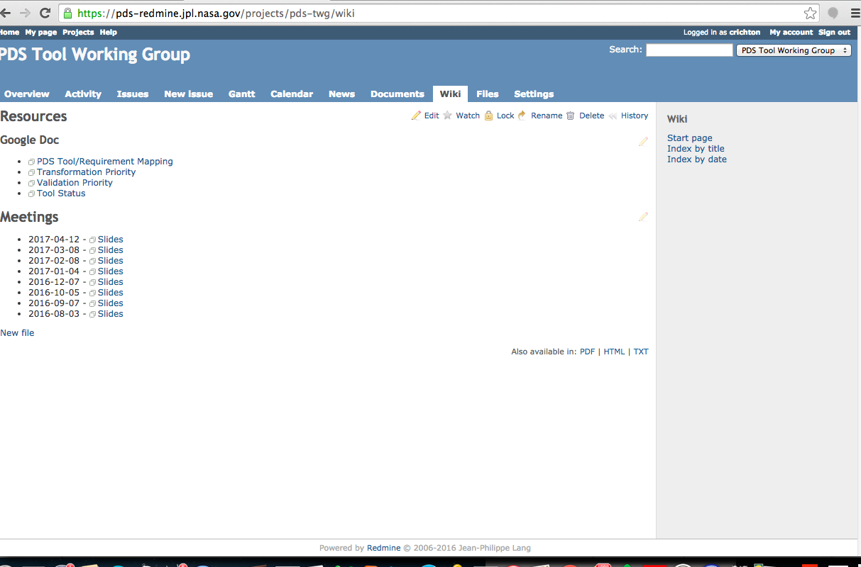
Introduction
The working group has focused on three activities to support current and future builds
Identifying the list of tools being developed within PDS and capturing capability and support plans
Identifying and classifying requirements for additional validation (including build dates)
Identifying and classifying additional transformations beyond the current set
The working group also mapped level 3 requirements to tools
PDS Tool WG Wiki

Slide 7
Level 3 Requirement Addition
Based on the requirements to tool mapping exercise, the team determined a gap with respect product design.
The following requirement was added to the PDS requirements document:
1.5.5 - PDS will provide tools to assist data producers in designing PDS compliant product labels.
Would like to discuss approval of requirement change in Exec Session.

Slide 8
PDS Tool Activities
The team is tracking status for actively developed tools at the EN and the DNs.
A traceability matrix was set up to map Level 3 requirements to Tools
Nodes were asked to identify tools beyond the list (on-going request)
This was facilitated with the following Google doc:
https://docs.google.com/spreadsheets/d/18oqtg3DEo2KrgvBOWLSOuqF2uZtq2XmByJwUknYSZUQ/edit#gid=1340660799

Slide 9
Tool Name | PDS Version | Developer/Maintainer | Current Status | Future Plan
PDS Label Assistant for Interactive Design (PLAID) (Formerly APPS LDT) | PDS4 | AMMOS | Released | New features planned and in development.
Educational Labeling System for Atmospheres (ELSA) | PDS4 | Atmospheres | In Development
Generate Tool | PDS4 | Engineering | Released | Routine maintenance. Plan to merge with igpp.docgen.
igpp.docgen | PDS4 | PPI | Released | Routine maintenance. Plan to merge with Generate Tool.
MakeLabels | PDS4 | Geosciences | In Development
LDDTool | PDS4 | Engineering | Released | Updated with each build.
Validate Tool | PDS3 PDS4 | Engineering | Released. Subtantial support for syntatic and semantic validation. | Focus on content validation. Updated with each build based on TWG prioritization.
Validation Tool (VTool) | PDS3 | Engineering | Released | Replaced by Validate Tool.
PDS3 Volume Validator | PDS3 | ARC/Engineering | Released | Decommission due to IT security issues.
Transform Tool | PDS4 | Engineering | Released. Support for a core set of transformations. | Focus on expanding beyond core set. Updated with each build based on TWG prioritization.
PDS4 Tools | PDS4 | Engineering | Released | Routine maintenance.
pds.cdf | PDS4 | PPI | Released | Routine maintenance.
ReadPDS4 for IDL | PDS4 | SBN | Released | Routine maintenance.
ReadPDS3 for IDL | PDS3 | SBN | Released | Routine maintenance.
InspectTool | PDS3 PDS4 | Engineering | Requirements/Design | Design underway. Initial release planned for Build 8a at end of FY17.
PDS4 Viewer | PDS4 | SBN | Released | Routine maintenance.
NASAView | PDS3 | Engineering | Released | Routine maintenance. Plan to replace with Inspect Tool.
PDS3 Table Slicer | PDS3 | ARC/Engineering | Released
Integrated Software for Imagers and Spectrometers (ISIS) | PDS3 | Imaging/USGS | Released
Online Archive Facility (OLAF) | PDS3 PDS4 | SBN-PSI | Released
AMMOS-PDS Pipeline Service (APPS) | PDS3 PDS4 | AMMOS | Released

Slide 10
Tool Registry
The application is available at:
http://pds.nasa.gov/tools/tool-registry
Migrations of the PDS Search Tools and IPDA Tools have been completed.
Beyond migrated entries, approximately 25+ new entries have been captured (current total of 69).
No new entries in the last couple of months.
Submissions have been reviewed by the TWG.

Slide 11
Transformation Prioritization
Today, the Transform Tools supports approximately 27 transformations as of the Build 7b release.
The team was tasked with adding to and prioritizing the list of supported transformations for the Transport Tool.
This was facilitated with the following Google doc:
https://docs.google.com/spreadsheets/d/18oqtg3DEo2KrgvBOWLSOuqF2uZtq2XmByJwUknYSZUQ/edit#gid=635102082

Slide 13
Transformation Prioritization cont.
The prioritization exercise identified the following as higher priority (assigned to builds):
Build 8a
PDS3 labeled tables to CSV
PDS4 label to PDS3 label (ODL)
Build 8b
PDS3 labeled tables to PDS4 labeled tables
PDS4 labeled tables to PDS4 labeled tables (e.g., binary to character)
Build 9a
Array 2D Map to GeoTIFF
Array 3D Spectrum to ENVI Cube
Array 2D Image to FITS

Slide 14
Validation Prioritization
The Validate Tool supports the following as of the Build 7b release:
Syntactic and semantic validation via the XML Schema and 350+ Schematron rules pertaining to PDS4 label structure and content.
Bundle and Collection referential integrity checking.
The team was recently tasked with prioritizing the validation requirements.
These focus primarily on specific content validation rules, many of which need to be individually written and schedule for release.
This was facilitated with the following Google doc:
https://docs.google.com/spreadsheets/d/18oqtg3DEo2KrgvBOWLSOuqF2uZtq2XmByJwUknYSZUQ/edit#gid=1268101288

Slide 15
PDS Validate Tool Support
Validation Type | Support
Syntactic Validation | Ensures accuracy of the grammar / syntax of the XML label against the appropriate schemas as well as any mission schema or schematron. Syntactic validation is largely complete.
Semantic Validation | Ensures accuracy of the semantic "meaning" of the XML label when run against all relevant schema and schematron files. PDS has about 350 schematron rules today that are in place.
Content Validation | Ensure accuracy of data against the description of the data in the label. Some content validation in place, but will be the focus of expanded support.
Referential Integrity | Ensures accuracy of relationships described in Bundle and Collection products in place today. Future Feature – Ensure that the relationships described, in and between observational and document objects described in the XML label, are consistent and represented.

Slide 17
Validation Prioritization cont.
Upcoming priorities (from TWG discussions):
Build 8a
Data content validation of tables against the label description.
Build 8b
Data content validation of arrays against the label description.
Additional integrity checks and lower priority requirements.
Will revisit once all Nodes have provided input.

Slide 18
Next Steps
Complete validation requirement prioritization.
Prioritize requirements and releases for Inspect Tool.
Prioritize node tools for discussion.
Continue generating tool “wish list” (need heavy input from the nodes)
Explore software deployment options including container technology
Define requirements for GUI front-ends (Validate)
PDS3 maintenance plans

Slide 19
Questions/Comments

Slide 20
Types of PDS4 Validation
Validation Type | Definition
Syntactic Validation | Validate the grammatical structure / syntax of the XML label
Semantic Validation | Validate that the interpretation of the values in the XML labels are consistent with the circumstances and contexts being described
Content Validation | Validate that the syntactic and semantic content of the XML label accurately describes the digital bits in the data objects being described (i.e., the physical structure and order of the bits are accurately described by the data objects in the xml label)
Referential Integrity | Validate that the relationships described, in and between digital objects described in the XML label, are consistent and represented

