Slide 1
Resource Catalog
April 20, 2017
Sean Hardman

Slide 2
Overview
The Resource Catalog provides an introductory interface for novice users (Providers as well as Consumers) to aide in directing them to the proper set of resources available across the PDS to match their request.
  Extensible to follow different decision paths
The vision of this effort is an interface similar to Turbo Tax, where the user is guided to resources through a series of questions.
  Previewed with the Tool WG at the April meeting

Slide 3
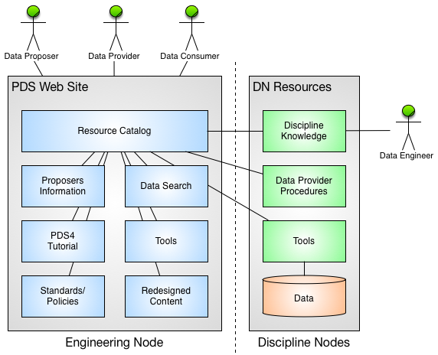
Architecture

Slide 4
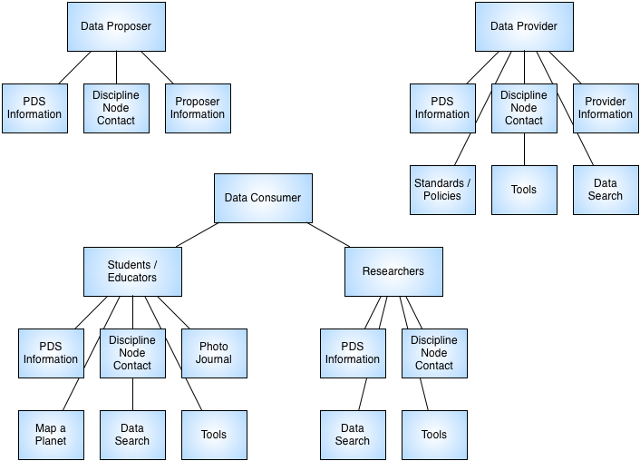
Decision Tree

Slide 5
Resource Catalog
(http://pds-gamma.jpl.nasa.gov)

Slide 6
Web Site Redesign
During this process we have also explored design options for the PDS home page/portal
  Fresh look-and-feel
  Better support for the Resource Catalog application.
  Better integration of the PDS3/PDS4 content.

Slide 7
Site Design Concept

Slide 8
Next Steps
Transition the Resource Catalog to operations.
  Continue to work on the decision tree and add additional resources as appropriate.
  Identify appropriate Discipline Node resources for integration into the application.
Integrate the application with the new PDS web site design.
  Review the design progress with the Tool WG.
  Discuss at the next MC F2F with targeted release with Build 8a (September 2017).

Slide 9
Questions/Comments

