Slide 1
PDS4 GIS Products:
Status update
Moses Milazzo
PDS IMG: USGS, Astrogeology
PDSMC F2F, April 19, 2017

Slide 2
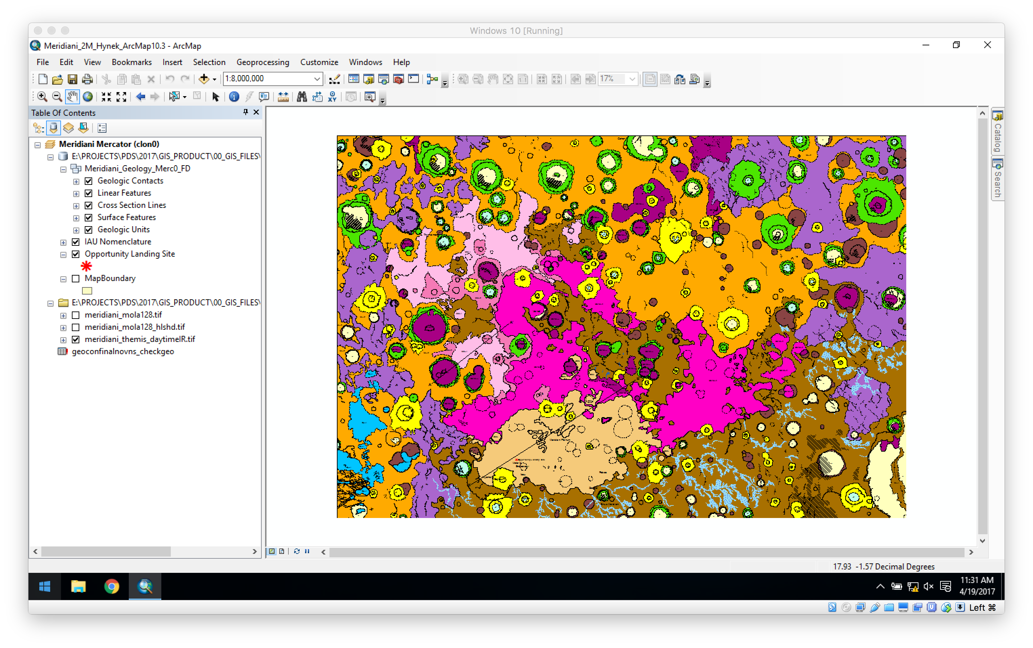
A Recap: What is GIS?

Slide 3
A Recap: What is GIS?
Geographic Information System is a system capable of capturing, storing, displaying, analyzing geographically referenced information.
GIS’s power is that it provides a way to relate different information in a spatial context and to allow scientists to reach conclusions about the relationships.
GIS is a framework for the “Science of Where.”

Slide 4
What does GIS provide?
Complex analysis is enabled
Information retrieval of all data at a specific location
Topology, Adjacency, Containment, Proximity, Networks, Overlays, …
Re-Use
Derived data can be re-incorporated into the GIS so inferences from the derived data can contribute to further analysis of the original data.
Cooperation
GIS provides a common interface and standards.
Planetary data collection, organization, and analysis is expensive.
GIS allows to share.

Slide 5
What is GML?
Geography Markup Language is the XML grammar defined by the Open Geospatial Consortium (OGC) to express geographical features in a GIS.
GML is a modeling language for GIS
GML is an open interchange format for GIS software applications.

Slide 6
What is GML?
GML primitives include:
Geometry
Feature
Coordinate Reference System
Topology
Time
Dynamic feature
Coverage
Unit of measure
Direction
Observations
Map presentation styling rules

Slide 7
What is GML?
GML is an ISO standard for GIS data (ISO 19136 for GML 3.2.1, approved in 2007)
An OGC standard for GIS use (GML 3.2.1)
Approved by the Library of Congress for archival of GIS products
Used by the Federal Geographic Data Consortium (FGDC) and National Spatial Data Infrastructure (NSDI).

Slide 8
Why GML for PDS4?
GIS products are being delivered to USGS regularly. We “archive” these in the Annex and also archive full geological maps with the USGS.
GML is a standard and stable language for GIS storage, interchange, and implementation
It is supported by all major and many minor GIS packages, including Free and Open software.
The FGDC/NSDI have implemented a GML Application Schema.

Slide 9
Why NOT GML for PDS4?
ARCInfo Shapefiles might be better.
Shapefiles are also a standard interchange format.
The Shapefile format is an “open” (but proprietary and binary) format.
Shapefiles are supported by all major and minor GIS packages as well as most shapefile visualization software.
Shapefiles are easier to generate for most users.

Slide 10
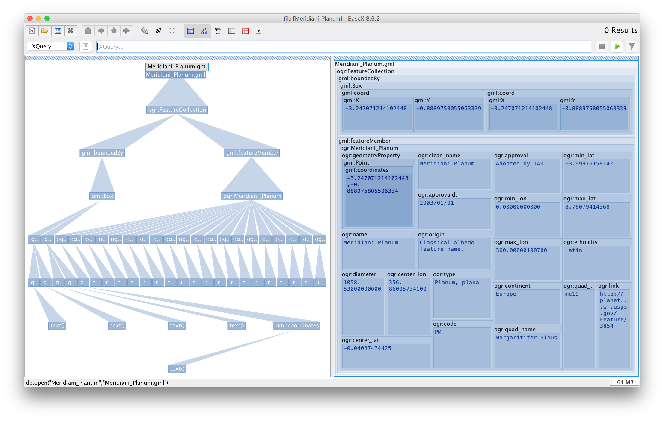
GML XML files can be explored with existing tools as well as visualized with GIS software.

Slide 11
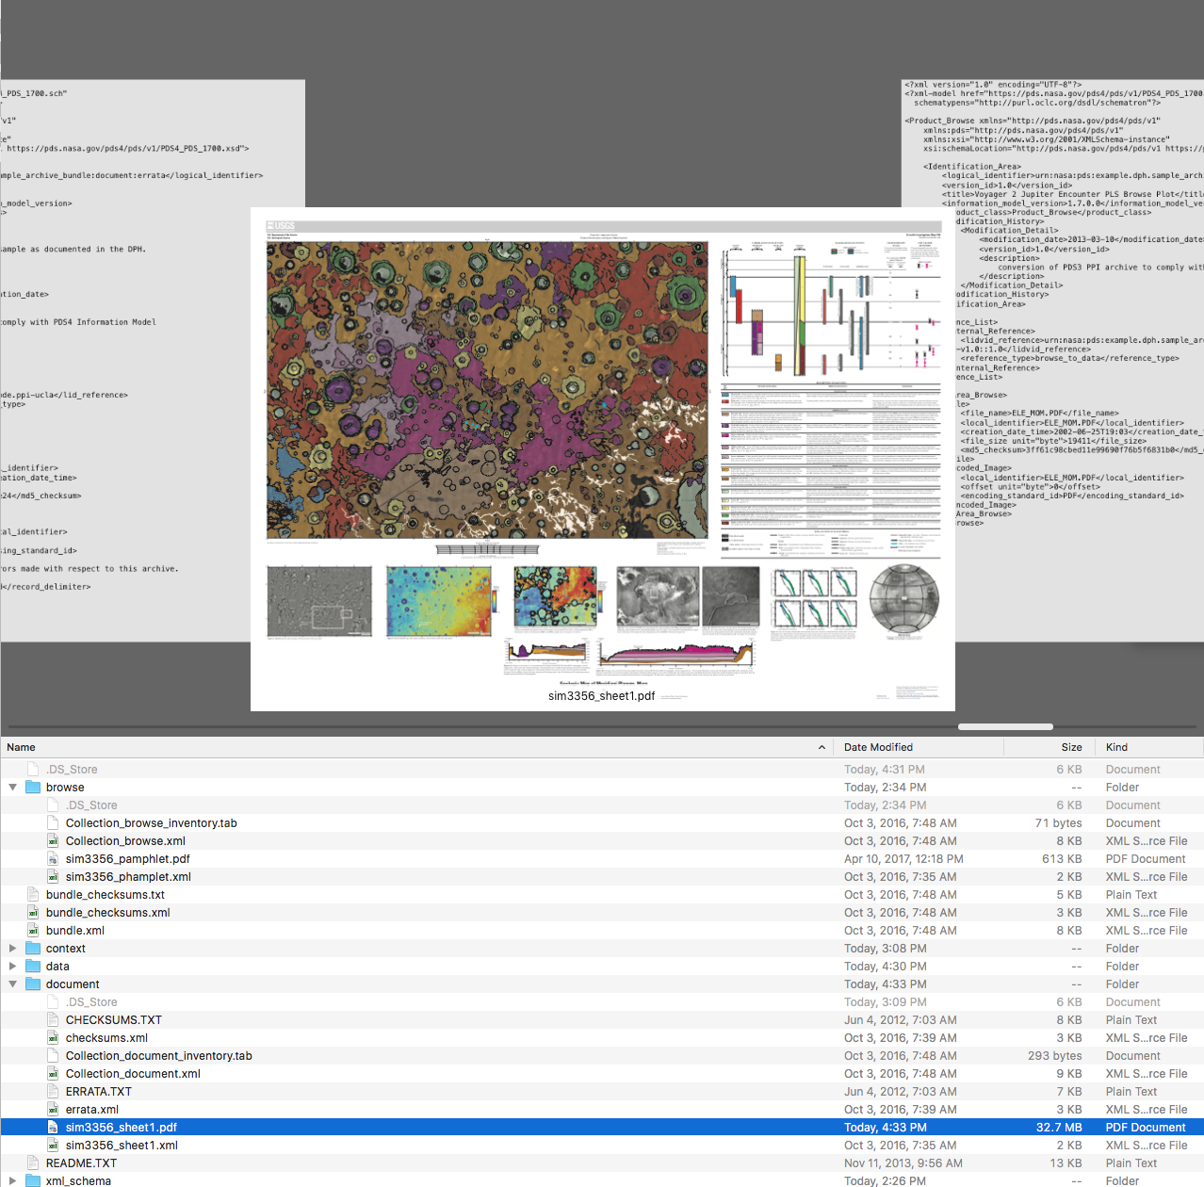
GML in PDS4
PDF document and browse products can easily be viewed with existing tools.

Slide 12
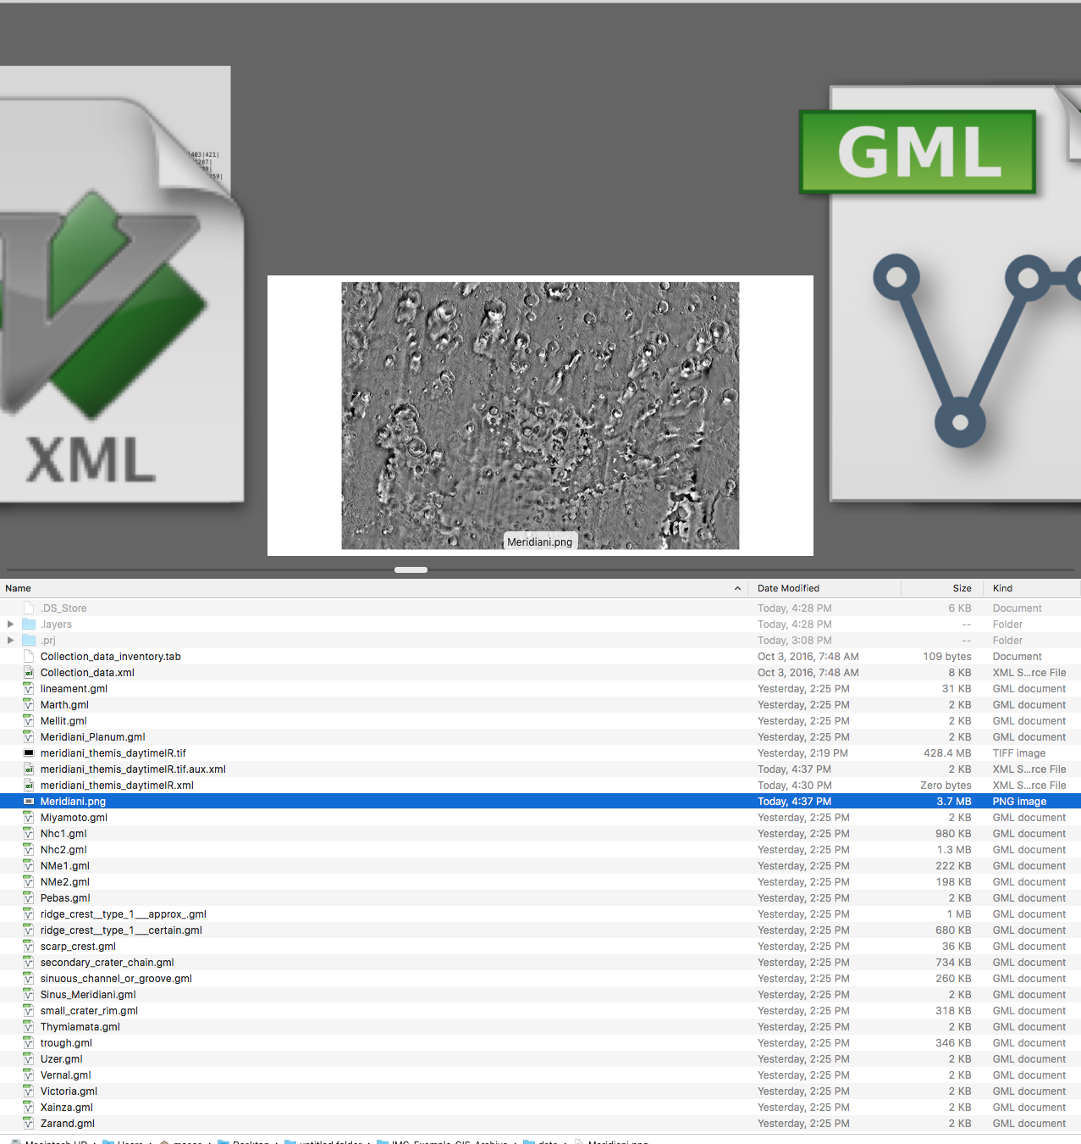
Raster layers can easily be viewed with PDS4 viewer tools.
2

Slide 13
Backup Slides

Slide 14
What is GML?
GML comprises a set of primitives which are used to build application-specific schemas.
Geometry
Describes a location or region, Point, LineString, Polygon
Feature
Application object that represents a physical entity (crater, lineament, etc.)
A feature’s location, extent, etc. is defined by associated Geomtries

Slide 15
A Recap: What is GIS?
Data incorporated into a GIS include
Image data
Spot data (LiDAR, spectral, etc.)
Geophysical data (seismographs, etc.)
Topography (contours, elevations, etc.)
Chemical data (in situ, spectral, etc.)
Geological maps
Geometry data
Tabular information
Etc., Etc., Etc.

Slide 16
Why include GIS in PDS4?
GIS is used for research and creation of derived data across the planetary science community, for data throughout the Solar System, and for Earth analog research.
It is a fundamental requirement to data fusion techniques that disparate data (imagery, LiDAR, geometry, etc.) be geolocated, visualized, and manipulated in a common software scheme.
Astrogeology provides unofficial archival of the human and robotic landing site studies as well as many other scientific studies.
Every geologic map published by USGS (terrestrial or planetary) is required to be in a GIS format.
The Library of Congress archives GIS-formatted data regularly.

Slide 17
What is GML?
A GML Profile is a restricted subset of the whole of GML and live within GML namespace.
GML Application Schemas are GML/XML vocabularies intended for domain- or community-specific uses.
Support interoperability within a community of interest.
Live in an application-defined target namespace.
“Application” does not necessarily imply a software implementation, but rather an application of GML to a specific need.

Slide 18
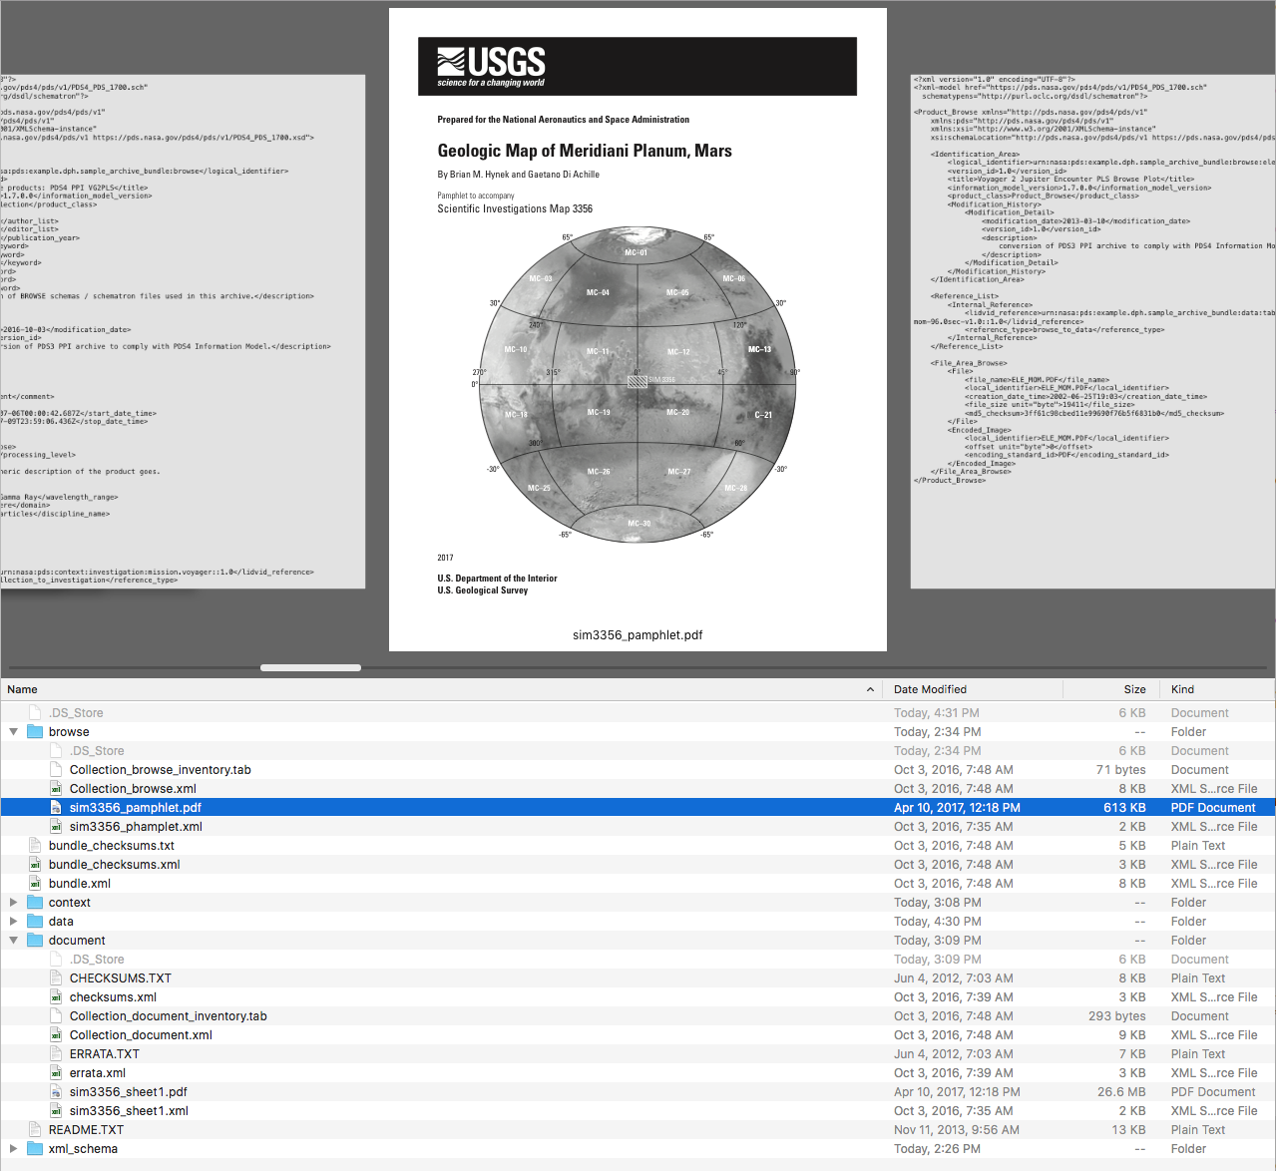
Other files conform to PDS4 Standards
2

Slide 19
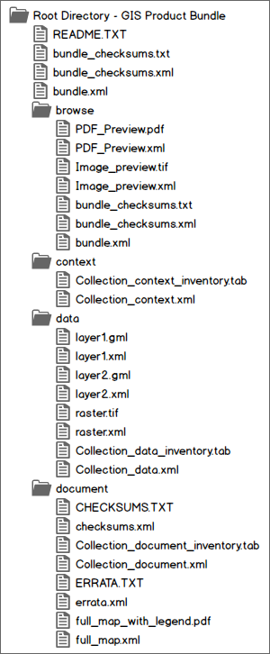
Most layers will be GML files (text; XML).
Basemaps and other raster images can be PDS4-compliant images.

Slide 20
Browse products can be IMG or PDF format.
Document products (project description, published papers, published map, etc.) can be text or PDF.

